Slide 1

Effects of finerenone in patients with hypertensive nephropathy
Hiddo J.L. Heerspink
On behalf of Jelle M. Beernink, Rajiv Agarwal, David Z.I. Cherney, Carolyn S.P. Lam, Brendon L. Neuen, Vlado Perkovic, Katherine R. Tuttle, Pantelis Sarafidis, Niels Jongs, J. David Smeijer, Meike Brinker, Juliana D. Reis, Christoph Wanner and the FIND-CKD Investigators

Slide 2
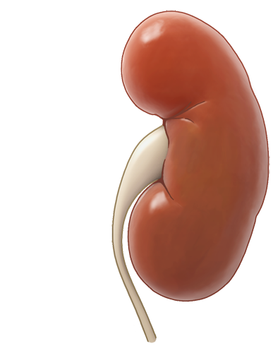
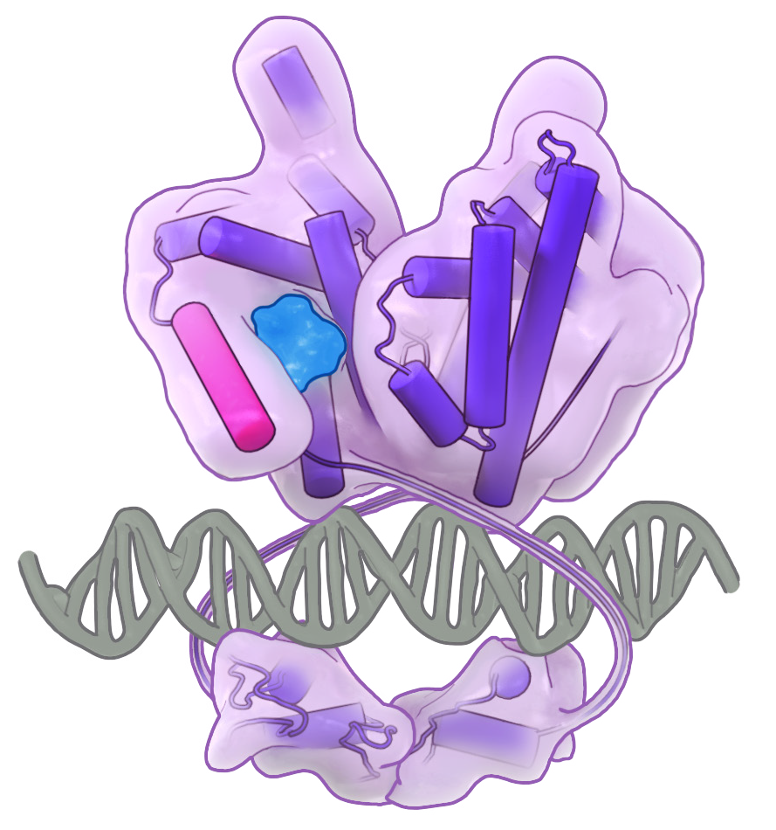


Introduction
Hypertensive nephropathy is a common cause of CKD and is associated with substantial residual risk of kidney function decline despite treatment with contemporary guideline-directed therapies*^{,1–3}
MR
Overactivation of the mineralocorticoid receptor is implicated in the pathophysiology of hypertensive nephropathy^{4–6}
Finerenone is a selective, nonsteroidal mineralocorticoid receptor antagonist that targets inflammatory and fibrotic pathways mediated by mineralocorticoid receptor overactivation in the heart and kidney⁷
MR

Slide 3
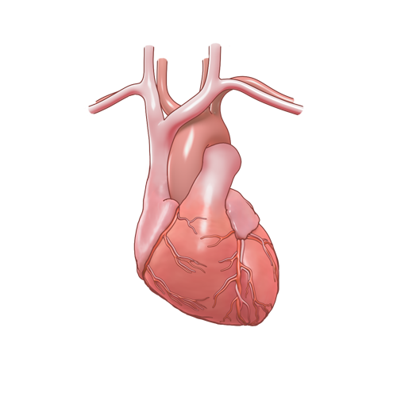
Introduction
The FIND-CKD trial demonstrated that finerenone slows CKD progression
in participants with CKD without diabetes¹
Total eGFR slope*
Kidney–cardiovascular composite§
2
30
HR=0.77
(95% CI 0.60, 0.99)
p=0.043
0
–2
25
–4
Placebo
No. of participants with event: 134 (16.9%)
n per 100 PY (95% CI): 5.8 (4.9, 6.9)
–6
1.3
20
–8
Finerenone
Mean (95% CI) eGFR change
from baseline (ml/min/1.73 m²)
Cumulative incidence (%)
–10
15
–12
Total eGFR slope up to month 32 (95% CI) (ml/min/1.73 m²/year):
Finerenone: –3.3 (–3.6, –3.1)
Placebo: –4.0 (–4.3, –3.8)
Difference: 0.7 (0.3, 1.1)
Finerenone
No. of participants with event: 110 (13.9%)
n per 100 PY (95% CI): 4.7 (3.9, 5.6)
–14
Placebo
–0.3
10
–16
–18
5
–20
–22
0
0
3
6
9
12
16
20
24
28
32
36
40
44
0
1
3
6
9
12
16
20
24
28
32
36
40
44
EOT
visit#
FU
visit‡
At risk (n)
Months since randomisation
Months since randomisation
Placebo
791
777
775
762
760
754
744
733
7
1
1
702
699
497
328
175
594
593
791
793
782
786
778
777
766
767
755
753
744
735
731
724
714
708
680
688
624
639
429
471
253
305
124
152
Finerenone
793
777
780
768
762
751
742
732
722
7
1
1
7
1
1
528
361
193
637
608
This prespecified analysis assessed the efficacy and safety of finerenone in
FIND-CKD participants with non-diabetic CKD due to hypertensive nephropathy

Slide 4


FIND-CKD study design^{1,2}
N=1584
R
1:1
Finerenone 10 or 20 mg od* (n=793)
Placebo (n=791)
Visits at screening, baseline and months 1, 3, 6, 9 and 12; thereafter every 4 months till end of study
End of treatment ≥Month 32
Follow-up
1 month post-treatment
Key inclusion criteria
Key exclusion criteria
  Age ≥18 years
  UACR ≥200 to <500 mg/g and
  eGFR ≥25 to <60 ml/min/1.73 m² OR UACR ≥500 to ≤3500 mg/g and eGFR ≥25 to <90 ml/min/1.73 m²
Stable maximal tolerated labelled dose of ACEi/ARB for ≥4 weeks
Serum potassium ≤4.8 mmol/l
  T1D or T2D, or HbA1c ≥6.5% (≥48 mmol/mol)
  Kidney disease requiring immunosuppressive therapy#
  Other kidney disease‡
  SBP ≥160 mmHg or DBP ≥100 mmHg
  Symptomatic HFrEF with Class IA indication for MRAs

Slide 5

FIND-CKD hypertensive nephropathy subgroup analysis
FIND-CKD included a broad population with common
non-diabetic CKD aetiologies well represented¹
Outcomes assessed in the overall FIND-CKD population were evaluated for participants with investigator-reported hypertensive nephropathy at baseline
Unknown
n=169
Primary outcome* – total eGFR slope
Mean annual rate of change in eGFR from baseline to month 32
Other
n=53
Secondary efficacy outcomes*
Kidney–CV composite: kidney failure,# sustained ≥57% eGFR decline, HHF or CV death
Kidney composite: kidney failure or sustained ≥57% eGFR decline
CV composite: HHF or CV death
Hypertensive nephropathy
n=459
Exploratory outcomes
Chronic eGFR slope‡
Change from baseline in UACR and SBP
  Safety outcomes
Treatment-emergent adverse events
Serious adverse events
Hyperkalaemia
Chronic glomerulonephritis n=903
Outcomes were stratified by a subgroup of interest:
participants with SBP above or below 130 mmHg

Slide 6
Baseline characteristics
Characteristic | Finerenone (n=234) | Placebo (n=225) | Overall HTN (N=459)
Age, years, mean (SD) | 61.2 (12.8) | 61.3 (13.6) | 61.2 (13.2)
Sex, female, n (%) | 51 (21.8) | 56 (24.9) | 107 (23.3)
Race, n (%)
White | 125 (53.4) | 121 (53.8) | 246 (53.6)
Asian | 93 (39.7) | 95 (42.2) | 188 (41.0)
Black | 14 (6.0) | 6 (2.7) | 20 (4.4)
Other* | 2 (0.9) | 3 (1.3) | 5 (1.1)
Body weight, kg, mean (SD) | 84.0 (19.7) | 82.2 (19.1) | 83.1 (19.4)
HbA1c, %, mean (SD)# | 5.6 (0.4) | 5.6 (0.4) | 5.6 (0.4)
Serum potassium, mmol/l, mean (SD) | 4.4 (0.5) | 4.5 (0.5) | 4.4 (0.5)
SBP, mmHg, mean (SD) | 134 (13) | 134 (14) | 134 (14)
<130 mmHg | 88 (37.6) | 80 (35.6) | 168 (36.6)
≥130 mmHg | 146 (62.4) | 145 (64.4) | 291 (63.4)
DBP, mmHg, mean (SD) | 80 (9) | 81 (11) | 80 (10)
Characteristic | Finerenone (n=234) | Placebo (n=225) | Overall HTN (N=459)
Medical history, n (%)
Atherosclerotic CVD | 49 (20.9) | 57 (25.3) | 106 (23.1)
Heart failure | 10 (4.3) | 12 (5.3) | 22 (4.8)
eGFR, ml/min/1.73 m², mean (SD) | 44 (15) | 44 (15) | 44 (15)
<45 ml/min/1.73 m², n (%) | 144 (61.5) | 136 (60.4) | 280 (61.0)
≥45 ml/min/1.73 m², n (%) | 90 (38.5) | 89 (39.6) | 179 (39.0)
UACR, mg/g, median (Q1, Q3) | 778 (553, 1231) | 844 (575, 1266) | 797 (566, 1247)
≤1000 mg/g, n (%) | 152 (65.0) | 142 (63.1) | 294 (64.1)
>1000 mg/g, n (%) | 82 (35.0) | 83 (36.9) | 165 (35.9)
Medication use, n (%)
SGLT-2i | 30 (12.8) | 25 (11.1) | 55 (12.0)
ACE inhibitor | 73 (31.2) | 54 (24.0) | 127 (27.7)
ARB | 160 (68.4) | 171 (76.0) | 331 (72.1)
Diuretics | 64 (27.4) | 64 (28.4) | 128 (27.9)
Beta blocker | 88 (37.6) | 95 (42.2) | 183 (39.9)
Calcium antagonist | 149 (63.7) | 153 (68.0) | 302 (65.8)
Baseline characteristics in participants with hypertensive nephropathy were
broadly consistent with the overall FIND-CKD population

Slide 7
eGFR slope
Change in eGFR from baseline over time*
eGFR slopes stratified by baseline SBP
Finerenone
Placebo
Total slope§
Chronic slope¶
2
Finerenone
Placebo
0
–2
1.1
–6
Change from baseline in eGFR
(ml/min/1.73 m²)
–10
–14
Mean annualised eGFR change from baseline at month 32 (ml/min/1.73 m²/year):
Finerenone: −3.17 (95% CI, −3.58, −2.75)
Placebo: −3.82 (95% CI, −4.30, −3.34)
Treatment difference: 0.65 (95% CI, 0.02, 1.29)
0.0
–18
Treatment difference (ml/min/1.73 m²/year):
–22
0
1
3
6
9
12
16
20
24
28
32
36
40
44
EOT
visit#
FU
visit‡
Months since randomisation
0.63
(95% CI
–0.42, 1.68)
0.66
(95% CI
–0.14, 1.47)
1.05
(95% CI
–0.07, 2.18)
1.23
(95% CI
0.37, 2.09)
At risk (n)
Finerenone
234
228
231
226
224
217
218
218
214
206
210
160
113
61
183
173
p-interaction: 0.960
p-interaction: 0.810
Placebo
225
221
220
218
215
213
210
208
202
198
192
140
97
61
169
168
*Analysed using a two-slope linear spline mixed-effects model in accordance with Vonesh E, et al. 2019 with fixed change point at month 3 to characterise acute and chronic eGFR slopes. The model included fixed effects for treatment, time, treatment-by-time interaction, baseline eGFR, screening UACR stratum, and baseline SGLT-2i use, with random effects for intercept, acute slope and chronic slope; ; #took place when the last randomised participant reached 32 months of treatment; ‡took place approximately 1 month after last administration of study drug; §mean annualised change in eGFR from baseline to month 32; ¶mean annualised change in eGFR from month 3 to end of treatment. CI, confidence interval; eGFR, estimated glomerular filtration rate; EOT, end of treatment; FU, follow-up; SBP, systolic blood pressure; SGLT-2i, sodium-glucose co-transporter-2 inhibitor; UACR, urine albumin-to-creatinine ratio

Slide 8
Secondary efficacy outcomes
Composite kidney–CV outcome*
Kidney failure# or sustained ≥57%
eGFR decrease
30
HR=0.61 (95% CI 0.38, 0.99)
30
HR=0.61 (95% CI 0.36, 1.03)
25
25
Placebo
No. of participants with event: 42 (18.7%)
n per 100 PY: 6.5
Placebo
No. of participants with event: 36 (16.0%)
n per 100 PY: 5.5
20
20
Cumulative incidence (%)
Cumulative incidence (%)
15
Finerenone
No. of participants with event: 28 (12.0%)
n per 100 PY: 4.0
15
Finerenone
No. of participants with event: 24 (10.3%)
n per 100 PY: 3.4
10
10
5
5
0
0
0
6
12
18
24
30
36
42
0
6
12
18
24
30
36
42
Months to first event
Months to first event
At risk (n)
At risk (n)
Finerenone
234
228
222
217
205
199
142
62
Finerenone
234
228
223
219
207
201
143
62
Placebo
225
219
211
205
194
185
110
57
Placebo
225
219
211
205
195
186
112
58

Slide 9
Secondary efficacy outcomes
HHF or CV death
Kidney failure* or sustained ≥40%
eGFR decrease
10
HR=0.87 (95% CI 0.29, 2.59)
40
HR=0.73 (95% CI 0.50, 1.07)
8
Placebo
No. of participants with event: 7 (3.1%)
n per 100 PY: 1.0
30
Placebo
No. of participants with event: 62 (27.6%)
n per 100 PY: 10.0
6
Cumulative incidence (%)
Cumulative incidence (%)
Finerenone
No. of participants with event: 6 (2.6%)
n per 100 PY: 0.8
20
Finerenone
No. of participants with event: 50 (21.4%)
n per 100 PY: 7.4
4
2
10
0
0
0
6
12
18
24
30
36
42
0
6
12
18
24
30
36
42
Months to first event
Months to first event
At risk (n)
At risk (n)
Finerenone
234
233
229
228
226
224
163
74
Finerenone
234
228
222
216
199
190
132
53
Placebo
225
223
219
218
216
214
142
72
Placebo
225
218
210
203
185
170
96
49

Slide 10
Exploratory outcome
Change from baseline in UACR over time
30
Placebo
20
Median UACR, mg/g (Q1, Q3) at baseline
Finerenone: 777.6 (552.8, 1230.7)
Placebo: 843.6 (575.3, 1266.2)
Finerenone
10
–2.9%
0
–10
–20
+18.2%
Change from baseline in UACR (%)
–30
–40
–50
Treatment
difference, %
(95% CI)
–33%
(–23%, –41%)
–36%
(–26%, –45%)
–39%
(– 27%, – 50%)
–60
–70
0
1
3
6
12
24
EOT
visit*
FU
visit#
At risk (n)
Months since randomisation
Finerenone
234
230
231
226
218
208
183
174
Placebo
225
224
218
217
210
200
170
167

Slide 11
Exploratory outcomes
Change from baseline in systolic blood pressure
Change from baseline in serum potassium
Change from baseline (mmHg)
Change from baseline (mmol/l)
Mean blood pressure at baseline:
Finerenone: 134/80 mmHg
Placebo: 134/81 mmHg
Mean (SD) serum potassium at baseline:
Finerenone: 4.4 (0.5) mmol/l
Placebo: 4.5 (0.5) mmol/l
1
3
6
1
3
6
At risk (n)
Finerenone
Placebo
Months since randomisation
Months since randomisation
234
225
230
224
229
221
226
220
220
213
220
212
217
207
211
206
208
200
197
184
153
129
96
82
44
43
234
225
225
219
227
218
223
217
212
210
216
207
214
208
212
202
204
196
207
198
160
142
112
98
60
61
Difference at month 6: –3.50 (95% CI –6.01, –0.99)
Difference at month 1: 0.16 (95% CI 0.09, 0.23)
Change from baseline calculated using MMRM
CI, confidence interval; MMRM, mixed model for repeated measures; SD, standard deviation

Slide 12
Investigator-reported adverse events
Finerenone (n=234)
Placebo (n=225)
Adverse events
Serious adverse events
Hyperkalaemia*
Participants (%)

Slide 13
Summary
Thank you
In FIND-CKD participants with hypertensive nephropathy, finerenone versus placebo:
Slowed CKD progression defined by total eGFR slope
Reduced the risk of the composite kidney–CV outcome
Reduced systolic blood pressure and albuminuria
at 6 months, an effect sustained throughout the treatment period
Safety events were consistent with the overall trial population
Hyperkalaemia occurred more frequently with finerenone than with placebo, but hospitalisation and permanent treatment discontinuation due to hyperkalaemia were uncommon
This prespecified subgroup analysis supports blockade of mineralocorticoid receptor overactivation as a therapeutically relevant treatment pathway in individuals with non-diabetic CKD due to hypertensive nephropathy
We thank all participating patients and their families

