Slide 1

Finerenone in patients with chronic kidney disease

Slide 2
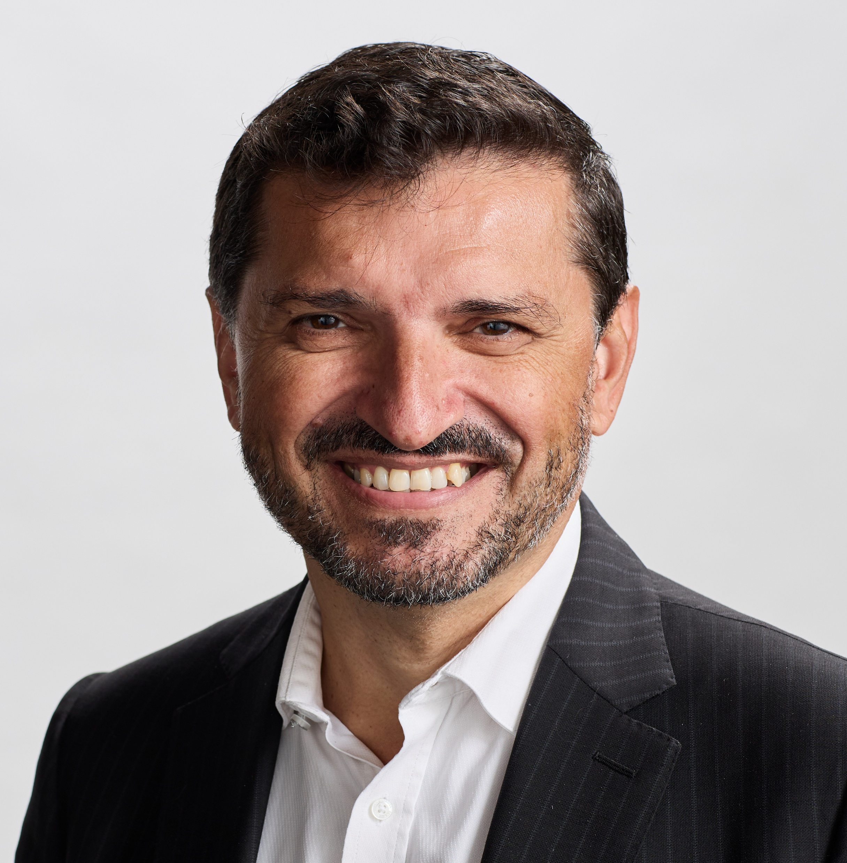
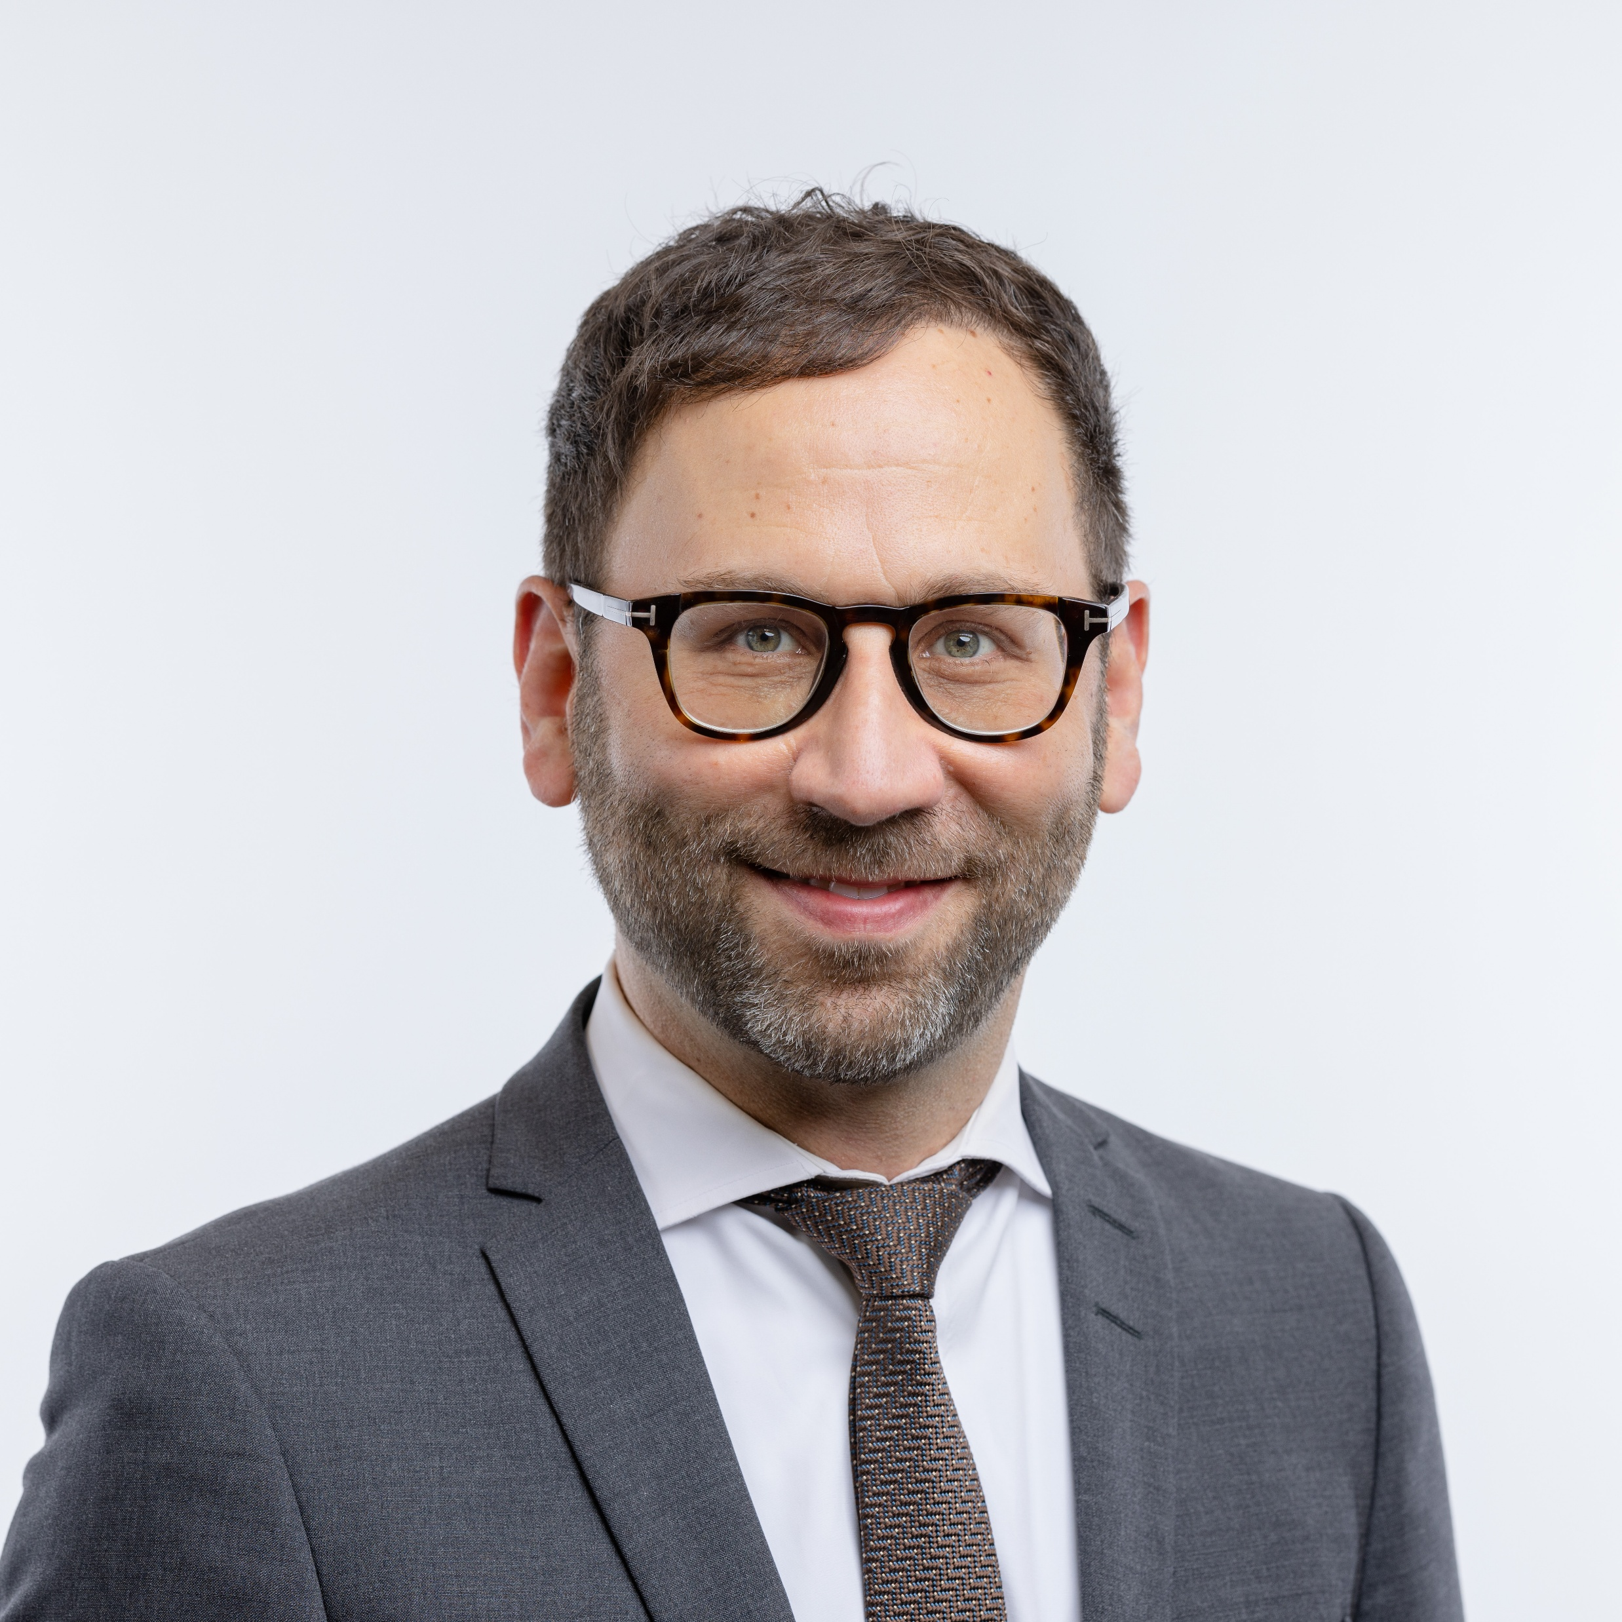
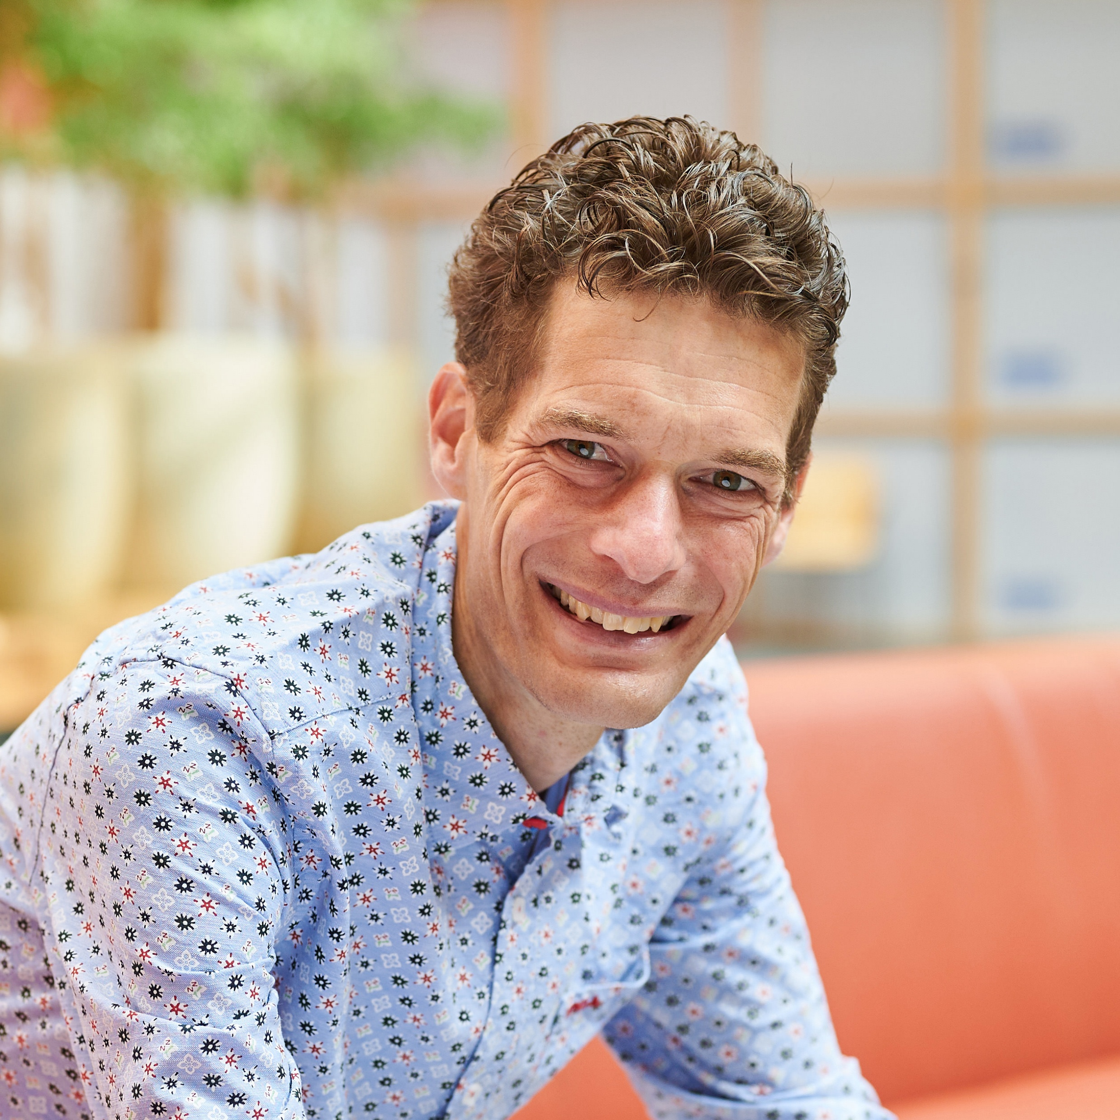
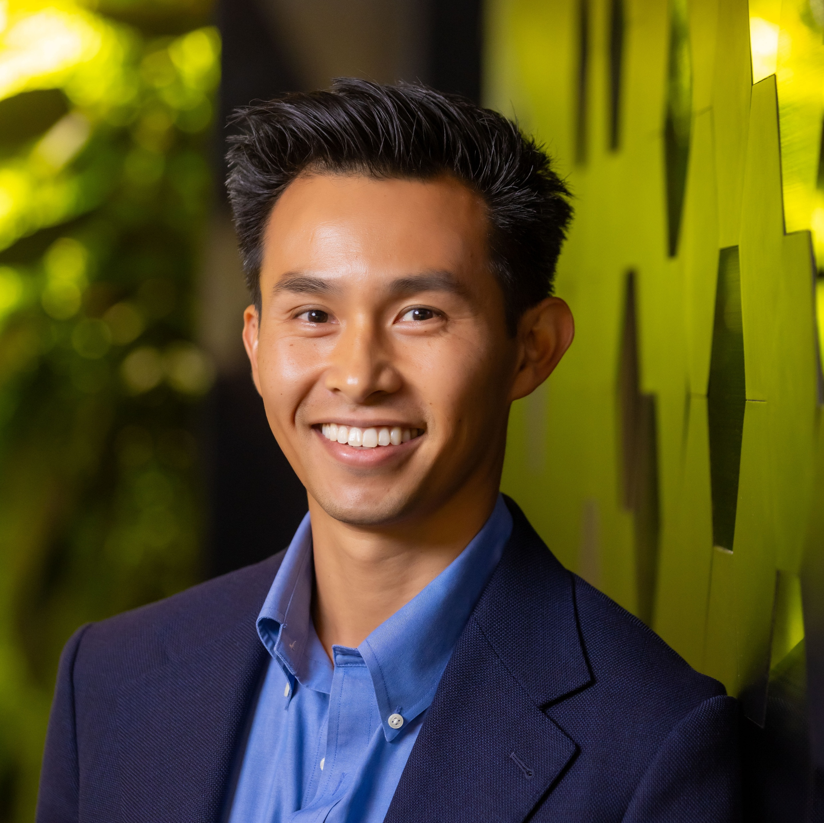
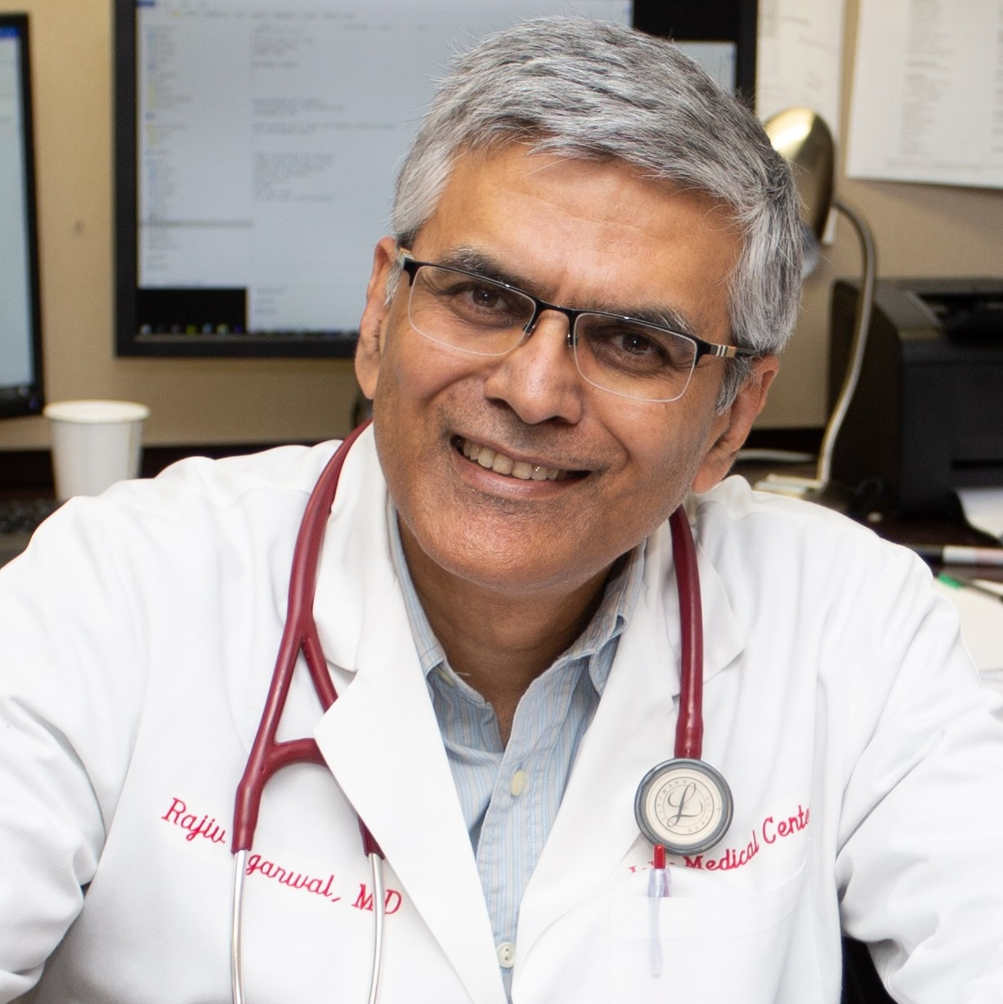
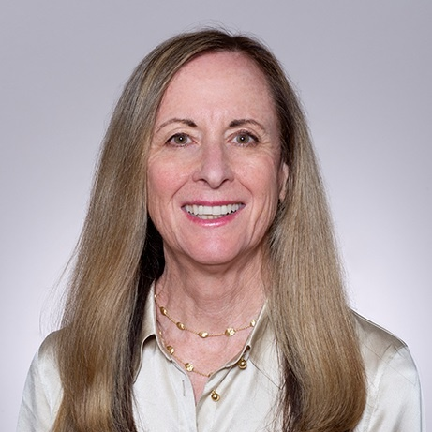

Speakers
Vlado Perkovic
David Cherney
Hiddo Heerspink
Brendon Neuen
Rajiv Agarwal
Katherine Tuttle
University of New South Wales
Sydney,
Australia
University of
Toronto
Toronto,
Canada
University of Groningen
Groningen,
the Netherlands
The George Institute for Global Health
Sydney,
Australia
Indiana University School of Medicine
Indianapolis,
IN, USA
University of Washington School of Medicine
Spokane,
WA, USA

Slide 3
Speaker disclosures: Vlado Perkovic
Is an employee of UNSW Sydney
Has a professorial fellowship at the George Institute for Global Health
Is a Non-Executive Board Director for St. Vincents Health Australia, Kidney Health Australia and Mindgardens Neuroscience Network
Advised for and/or led or served on the Steering Committees of trials funded by AbbVie, Alebund, Astra Zeneca, Bayer, Biogen, Boehringer Ingelheim, Cajal Consulting, CSL, Eli Lilly, Gilead, GSK, Guard Therapeutics, Incyte, Jade, Janssen, Mineralys, Novartis, Novo Nordisk, Otsuka, Purespring, Remegen, Sidera, Shanxi Micot, Sitala, Travere, and Tricida
Has stock in Emerald Clinical
The FIND-CKD trial was funded by Bayer AG

Slide 4







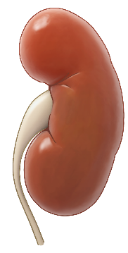










Global burden of CKD
Vascular
T1D
~ 400 to 550 million people globally with non-diabetic
CKD^{3,4}
Glomerular
~30%
of people with T1D
develop DKD¹
Hereditary
and congenital
DIABETIC KIDNEY DISEASE
NON-DIABETIC KIDNEY DISEASE
800
MILLION
people with CKD³
30–50%
50–70%
of all CKD cases²
of all CKD cases⁴
Unknown
aetiology
Tubulointerstitial
~40%
of people with T2D
develop DKD¹
T2D
Infectious
and obstructive

Slide 5




Unmet need in ndCKD
Late diagnosis and variable presentation²
Risk of progression despite current SOC³
ndCKD
High risk of kidney failure and CV complications³
Under-representation in clinical trials³
50–70%
of all CKD cases¹
Limited disease-modifying therapies^{1,4,5}
Integration of new therapies into care pathways⁶

Slide 6
Treatment paradigm in diabetic and non-diabetic kidney disease
Diabetic
kidney disease
Non-diabetic
kidney disease
Aetiology-specific therapies
RASi
SGLT2i
Finerenone
GLP-1RA
RASi
SGLT2i
Finerenone?
Comprehensive lifestyle and risk factor modification
Additive benefits
Addressing multiple disease mechanisms
Larger anticipated improvements in albuminuria and eGFR decline
Enhanced heart protection

Slide 7
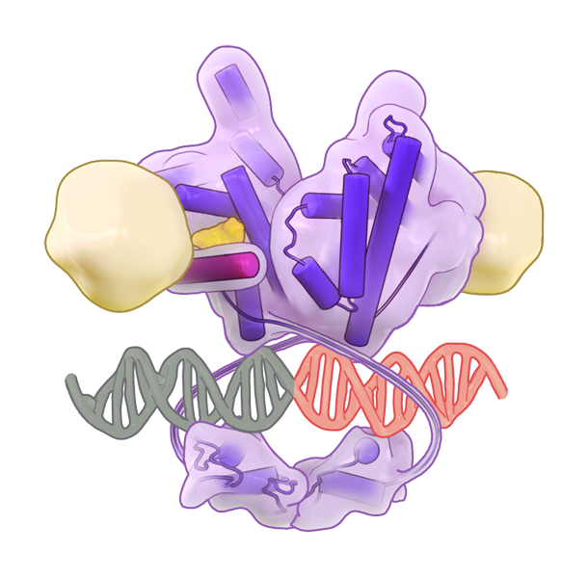
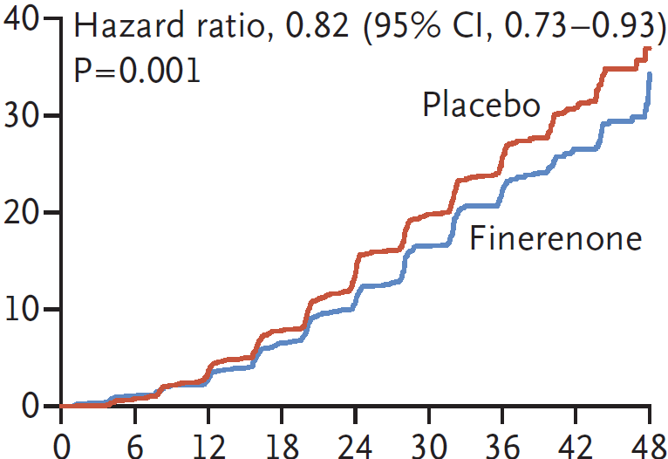
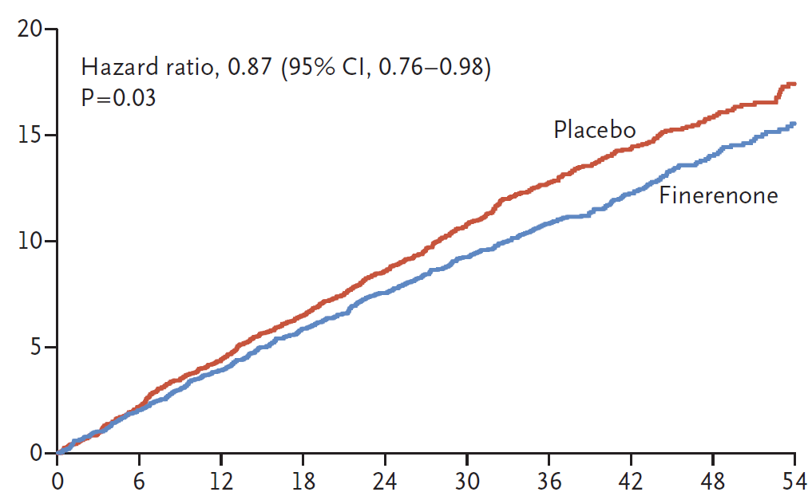
MR overactivation in CKD
Diabetic CKD¹
?
nd-CKD^{3,4}
MR overactivation²
Activates hemodynamic, inflammatory and fibrotic pathways²
Glomerular
RAAS/SNS upregulation, oxidative stress or inflammatory signaling²
Tubulointerstitial
Vascular
Finerenone in CKD and T2D
Other
FIDELIO-DKD⁵
Composite
kidney outcome
Shared injury mechanisms
Podocyte loss^{3,4}
Proteinuria^{3,4}
Tubulointerstitial damage and/or inflammation^{3,4}
Glomerulosclerosis^{3,4}
Mesangial expansion⁴
Glomerular hypertrophy⁴
FIGARO-DKD⁶
Composite cardiovascular
outcome
CKD progression

Slide 8
Aim:
To investigate the efficacy and safety of Finerenone, In addition to standard of care, on the progression of kidney disease in patients with Non-Diabetic Chronic Kidney Disease

Slide 9
Agenda
Title | Presenter
Introduction: The finerenone in non-diabetic chronic kidney disease (FIND-CKD) trial | Vlado Perkovic
FIND-CKD study design and baseline characteristics | David Cherney
FIND-CKD efficacy and safety | Hiddo Heerspink
Finerenone in patients with glomerular diseases | Brendon Neuen
Individual participant data pooled analysis of finerenone in chronic kidney disease (INFINITY) | Rajiv Agarwal
Clinical interpretation | Katherine Tuttle
Q&A | Vlado Perkovic

Slide 10
FIND-CKD study design and baseline characteristics
David Z. I. Cherney

Slide 11
Speaker disclosures: David Z. I. Cherney
Has received honoraria from Boehringer Ingelheim–Lilly, Merck, AstraZeneca, Sanofi, Mitsubishi-Tanabe, AbbVie, Janssen, Amgen, Bayer, Prometic, Bristol Myers Squibb, Maze, Gilead, CSL Behring, Otsuka, Novartis, Youngene, Lexicon, Inversago, GlaxoSmithKline, Biobridge, Vantage, Altimmune and Novo Nordisk
Has received operational funding for clinical trials from Boehringer Ingelheim-Lilly, Merck, Janssen, Sanofi, AstraZeneca, CSL Behring, Lexicon, Novo Nordisk and Bayer
The FIND-CKD trial was funded by Bayer AG

Slide 12


Eligibility criteria
Key inclusion criteria
Key exclusion criteria
Age ≥18 years
T1D, T2D, or HbA1c ≥6.5%
At screening
SBP ≥160 or DBP ≥100 mmHg
eGFR of ≥25 to <60 mL/min/1.73 m² and UACR of ≥200 to <500 mg/g*
Symptomatic HF with reduced
ejection fraction with class 1A
indication for MRAs
OR
eGFR ≥25 to <90 mL/min/1.73 m²
and UACR of ≥500 to ≤3500 mg/g
Autosomal dominant or autosomal recessive polycystic kidney disease
Serum potassium ≤4.8 mmol/L
Lupus nephritis or ANCA-associated vasculitis or any other kidney disease requiring immunosuppressive therapy
within 6 months prior to screening
On stable maximal tolerated labelled dose
of ACEi or ARB

Slide 13



FIND-CKD study design^{1,2}
Patients with nd-CKD at risk of progression despite optimised ACEi/ARB therapy were enrolled in the study
FIND-CKD is a multicentre, randomised, double-blind, placebo-controlled, phase III study
Primary endpoint
N=1584
Day -14
Mean annual rate of change in eGFR as measured by the total slope of eGFR
from baseline to Month 32
R
1:1
Finerenone 10 or 20 mg OD*
Screening
N=3231
Placebo
Total eGFR slope has been approved by multiple regulatory agencies as an endpoint in a wide range of kidney diseases
Visit 1
Day 1
End of treatment Month 32
Follow-up
~1 month
post-treatment
Visits
Every 3 months
up to Month 12
Every 4 months
till end of study
FIND-CKD was calculated to have >90% power assuming a mean annual rate of eGFR decline of
0.7mL/min/1.73m²/year less with finerenone versus placebo between baseline and month 32,
which was expected to translate to a relative reduction of 23% in the risk of adverse kidney outcomes

Slide 14
Use of eGFR slope as a clinical endpoint representing kidney function decline and long-term prognosis^{1–3}
Graphical representation of treatment effects on GFR slope as a kidney endpoint*
Acute effect: captures immediate short-term eGFR change
Total slope
0
Chronic slope
Chronic slope: evaluates rate of eGFR change after the acute phase
Acute
effect
Treatment
Mean change in eGFR
(mL/min/1.73 m²)
Total slope: encompasses overall change in eGFR
Placebo
Treatment period
Wash-out period
Follow-up time
Total eGFR slope has been approved by multiple regulatory agencies as an endpoint in a wide range of kidney diseases

Slide 15
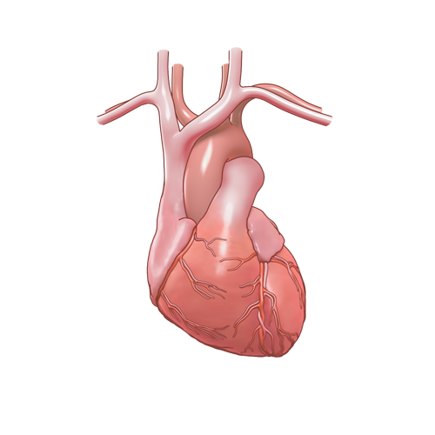
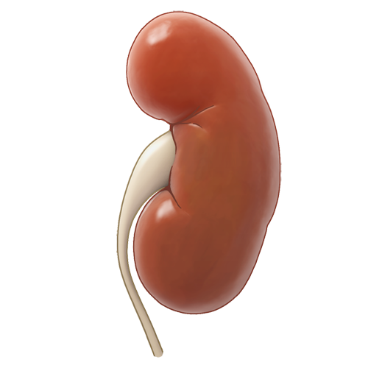


FIND-CKD secondary outcomes and safety^{1,2}
Secondary efficacy outcomes*
Combined kidney-CV outcome
  Composite of kidney failure,# sustained ≥57% eGFR decrease, HHF, or CV death
Kidney- and CV-specific composites
  Composite kidney outcome of kidney failure# or sustained ≥57% eGFR decrease
  Composite CV outcome of HHF or CV death
Safety outcomes
Kidney-related exploratory outcomes
Adverse events
Serious adverse events
Hyperkalaemia
eGFR change from baseline to off treatment‡
Chronic eGFR slope§
Kidney failure# or sustained ≥40% eGFR decrease
Change from baseline to month 6 in UACR

Slide 16
Patient disposition
3231 enrolled
1476 screening failures
1584 randomised
793 randomised to finerenone
791 randomised to placebo
793 included in FAS
793 were treated
636 completed treatment
157 did not complete treatment
791 included in FAS
791 were treated
614 completed treatment
177 did not complete treatment
786 completed study
4 did not complete study
  3 lost to follow-up
  1 withdrew consent
780 completed study
2 did not complete the study
1 lost to follow-up
1 withdrew consent

Slide 17
Baseline characteristics
Characteristic | Finerenone (n=793) | Placebo (n=791)
Age, years, mean | 55 | 55
Sex, male, n (%) | 518 (65.3) | 531 (67.1)
Race, n (%)
Asian | 447 (56.4) | 421 (53.2)
White | 308 (38.8) | 340 (43.0)
Black | 22 (2.8) | 15 (1.9)
Other* | 16 (2.0) | 15 (1.9)
Region, n (%)
Asia | 435 (54.9) | 409 (51.7)
Europe | 252 (31.8) | 283 (35.8)
North America | 72 (9.1) | 60 (7.6)
Latin America | 34 (4.3) | 39 (4.9)
BMI, kg/m², mean | 28 | 27
Serum [K+], mmol/l, mean | 4.5 | 4.5
eGFR, mL/min/1.73 m², mean | 47 | 47
UACR, mg/g, median | 828 | 811
Characteristic | Finerenone (n=793) | Placebo (n=791)
SBP, mm Hg, mean | 129.7 | 129.3
Medical history, n (%)
ASCVD | 90 (11.3) | 105 (13.3)
Hypertension | 701 (88.4) | 706 (89.3)
Heart failure | 16 (2.0) | 19 (2.4)
Primary cause of CKD, n (%)
Hypertensive/ischemic nephropathy | 234 (29.5) | 225 (28.4)
Chronic glomerulonephritis | 446 (56.2) | 457 (57.8)
Other# | 29 (3.7) | 24 (3.0)
Unknown | 84 (10.6) | 85 (10.7)
Medication use, n (%)
ACEi | 230 (29.0) | 205 (25.9)
ARB | 560 (70.6) | 585 (74.0)
Diuretics | 142 (17.9) | 148 (18.7)
SGLT2i | 135 (17.0) | 135 (17.1)

Slide 18
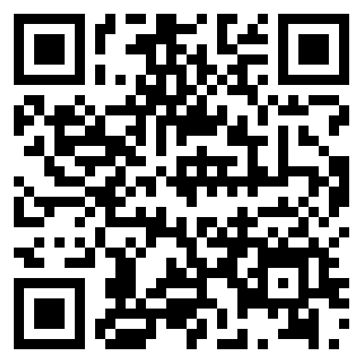

Nephrology dialysis transplantation
Hiddo J L Heerspink, Rajiv Agarwal, George L Bakris, et al, and the FIND-CKD Investigators
Design and baseline characteristics of the Finerenone, in addition to standard of care, on the progression of kidney disease in patients with Non-Diabetic Chronic Kidney Disease (FIND-CKD) randomized trial
Published online June 5, 2026
European Renal Association 63rd Congress
Scan to read the article

Slide 19
FIND-CKD efficacy and safety
Hiddo J. L. Heerspink

Slide 20
Speaker disclosures: Hiddo J. L. Heerspink
Has received honoraria from Bayer for participation in the FIND-CKD clinical trial steering committee (honoraria paid to employer University of Groningen)
Received grants from AstraZeneca, Bayer, Boehringer Ingelheim, Janssen and Novo Nordisk
Received consulting fees from AstraZeneca Alexion, Alnylam, Amgen, Bayer, Boehringer Ingelheim, Biocity Biopharmaceuticals, Dimerix, Eli Lilly, Novo Nordisk, Novartis, Roche and Travere Therapeutics
Received speaker fees from AstraZeneca, Bayer and Novo Nordisk
Received support for attending meetings and/or travel from AstraZeneca and Eli Lilly
The FIND-CKD trial was funded by Bayer AG

Slide 21
Total eGFR slope
Finerenone (n=793)
Total eGFR slope up to month 32, (95% CI):
–3.3 (–3.6, –3.1)
1.2
–0.5
Mean eGFR change from baseline
(mL/min/1.73 m²)
Difference: 0.7 (0.3, 1.1)
mL/min/1.73 m²/year
p=0.0003
Placebo (n=791)
Total eGFR slope up to month 32, (95% CI):
–4.0 (–4.3, –3.8)
Mean eGFR at baseline (ml/min/1.73m²)
Finerenone: 46.8
Placebo: 46.6
1
3
6
9
End of
treatment
visit*
Follow-up
visit#
Months since randomisation
At risk (n)
Placebo
791 | 777 | 775 | 762 | 760 | 754 | 744 | 733 | 711 | 702 | 699 | 497 | 328 | 175 | 384 | 593
793 | 777 | 780 | 768 | 762 | 751 | 742 | 732 | 722 | 711 | 711 | 528 | 361 | 193 | 403 | 609
Finerenone

Slide 22
eGFR slopes
Primary endpoint
Components of total slope
Total
Acute
Chronic
Finerenone
Placebo
-4.0
0.7
mL/min/1.73 m²/year
(95% CI, 0.3, 1.1)
–1.2
mL/min/1.73 m²/3 months
(95% CI, –1.8, –0.6)
1.2
mL/min/1.73 m²/year
(95% CI, 0.9, 1.6)

Slide 23
Total eGFR slope across prespecified subgroups
Annual eGFR decrease (ml/min/1.73 m²/year) | Finerenone |  | Placebo |  | Difference in slopes (95% CI) |  | p-value for interaction
 | n | eGFR slope | n | eGFR slope
Overall | 793 | –3.3 | 791 | –4.0 |  | 0.7 (0.3, 1.1)
Primary cause of CKD
Hypertension/ischemic nephropathy | 234 | –3.1 | 225 | –3.8 |  | 0.7 (0.0, 1.4) | 0.883
Chronic glomerulonephritis | 446 | –3.5 | 457 | –4.2 |  | 0.7 (0.2, 1.2)
Other/unknown | 113 | –3.1 | 109 | –3.6 |  | 0.5 (–0.5, 1.4)
eGFR (mL/min/1.73 m²)
<45 | 424 | –3.2 | 420 | –3.8 |  | 0.6 (0.1, 1.1) | 0.469
45–<60 | 207 | –3.3 | 216 | –4.3 |  | 1.0 (0.3, 1.7)
≥60 | 162 | –3.9 | 155 | –4.3 |  | 0.4 (–0.4, 1.2)
UACR (mg/g)
≤1000 | 491 | –2.7 | 491 | –3.1 |  | 0.4 (–0.1, 0.9) | 0.053
>1000 | 302 | –4.4 | 300 | –5.6 |  | 1.1 (0.6, 1.7)
SGLT2i use
Yes | 135 | –3.2 | 135 | –4.0 |  | 0.8 (–0.1, 1.7) | 0.712
No | 658 | –3.4 | 656 | –4.0 |  | 0.7 (0.3, 1.1)
Placebo better
Finerenone better

Slide 24
Composite kidney-CV outcome*
30
Hazard ratio, 0.77
(95% CI, 0.60, 0.99)
p=0.043
Placebo
No. of participants with event: 134 (16.9%)
n per 100 PY (95% CI): 5.8 (4.9, 6.9)
25
20
15
Cumulative incidence (%)
10
5
Finerenone
No. of participants with event: 110 (13.9%)
n per 100 PY (95% CI): 4.7 (3.9, 5.6)
0
0
3
6
9
12
16
20
24
28
32
36
40
44
Months since randomisation
At risk (n)
Placebo | 791 | 782 | 778 | 766 | 755 | 744 | 731 | 714 | 680 | 624 | 429 | 253 | 124
Finerenone | 793 | 786 | 777 | 767 | 753 | 735 | 724 | 708 | 688 | 639 | 471 | 305 | 152

Slide 25
Secondary efficacy outcomes*
Kidney failure or sustained ≥57%
eGFR decrease#
HF hospitalisation or CV death‡
30
Hazard ratio, 0.78
(95% CI, 0.60, 1.01)
30
Hazard ratio, 0.60
(95% CI, 0.27, 1.33)
25
25
20
Placebo
No. of participants with event: 125 (15.8%)
n per 100 PY (95% CI): 5.4 (4.5, 6.4)
20
Placebo
No. of participants with event: 16 (2.0%)
n per 100 PY (95% CI): 0.6 (0.4, 1.0)
15
15
Cumulative Incidence (%)
Cumulative Incidence (%)
10
Finerenone
No. of participants with event: 104 (13.1%)
n per 100 PY (95% CI): 4.4 (3.6, 5.3)
10
Finerenone
No. of participants with event: 10 (1.3%)
n per 100 PY (95% CI): 0.4 (0.2, 0.7)
5
5
0
0
0
3
6
9
12
16
20
24
28
32
36
40
44
0
3
6
9
12
16
20
24
28
32
36
40
44
Months since randomisation
Months since randomisation

Slide 26
Exploratory composite outcome
Kidney failure or sustained ≥40% eGFR decrease*
40
Hazard ratio, 0.76
(95% CI, 0.62, 0.93)
Placebo
No. of participants with event: 206 (26.0%)
n per 100 PY (95% CI): 9.3 (8.1, 10.6)
35
30
25
20
Cumulative Incidence (%)
15
10
Finerenone
No. of participants with event: 168 (21.2%)
n per 100 PY (95% CI): 7.4 (6.3, 8.5)
5
0
0
3
6
9
12
16
20
24
28
32
36
40
44
At risk (n)
Months since randomisation
Placebo
793
784
775
762
748
731
709
684
654
599
445
282
140
Finerenone
791
783
777
767
749
736
707
680
638
575
384
231
112

Slide 27
UACR exploratory outcome
≥30% UACR reduction from baseline at Month 6:
OR (95% CI): 3.99
(3.22, 4.95)
Placebo
56.0%
24.4%
Finerenone
vs
Geometric mean ratio to baseline
–35%*
(95% CI –40%, –31%)
–39%*
(95% CI –44%, –34%)
–37%*
(95% CI – 43%, – 30%)
with
finerenone
with
placebo
Median UACR (mg/g) at baseline
Finerenone: 827.5
Placebo: 810.7
1
3
6
Months since randomisation
At risk (n)
Placebo | 791 | 785 | 771 | 759 |  | 754 |  |  | 712
Finerenone | 793 | 782 | 777 | 768 |  | 752 |  |  | 716

Slide 28
Serum potassium
Difference in mean serum potassium at month 1 between treatment groups: 0.12 mmol/L
Finerenone
Placebo
Mean serum potassium (mmol/L)
Mean serum potassium at baseline:
Finerenone: 4.5±0.4 mmol/L
Placebo: 4.5±0.4 mmol/L
1
3
6
9
Months since randomisation
At risk (n)
Placebo | 791 | 773 | 770 | 758 | 755 | 751 | 741 | 735 | 709 | 708 | 717 | 511 | 337 | 178
Finerenone | 793 | 773 | 775 | 760 | 755 | 746 | 740 | 734 | 724 | 716 | 720 | 537 | 366 | 195
28

Slide 29
Adverse events
Finerenone (n=793)
Placebo (n=791)
Adverse events
Serious adverse events
Patients (%)

Slide 30
Adverse events
Finerenone (n=793)
Placebo (n=791)
Hyperkalaemia*
Central laboratory measurements#
Patients (%)

Slide 31



Summary
FIND-CKD was a
well conducted, global
phase III trial evaluating the efficacy and safety of finerenone in patients with CKD without diabetes
FIND-CKD met its primary and key secondary endpoints
Finerenone versus placebo significantly reduced the:
Mean annual rate of change in eGFR from baseline to month 32
Risk of the composite
kidney-CV outcome
Finerenone was well tolerated
Although there was a higher incidence of hyperkalaemia with finerenone than placebo, its clinical impact was minimal

Slide 32
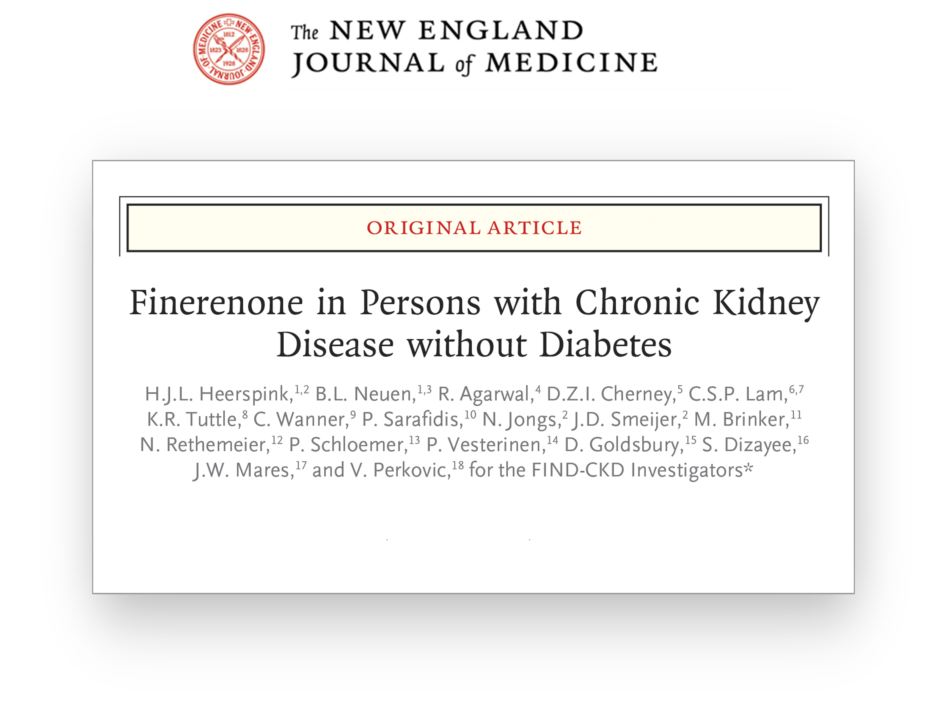
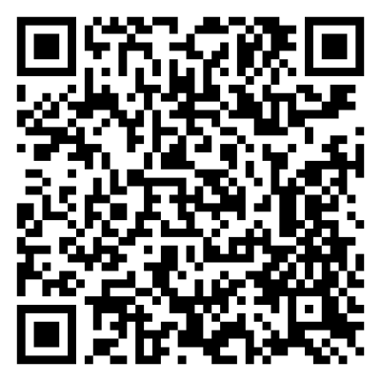
Published online June 4, 2026
European Renal Association 63rd Congress

Slide 33
Finerenone in patients with glomerular diseases
Brendon L. Neuen

Slide 34
Speaker disclosures: Brendon L. Neuen
Has received fees for advisory boards, scientific presentations, steering committee roles, travel and publication support from AstraZeneca, Alexion, Bayer, Boehringer and Ingelheim, Cornerstone Medical Education, CSL-Behring, CSL-Seqirus, the Limbic, Medscape, Menarini, MJH Life Sciences, Proton Intelligence, Novo Nordisk, Otsuka, Travere, and Vera Therapeutics
The FIND-CKD trial was funded by Bayer AG

Slide 35
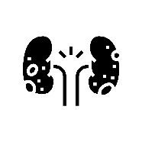
FIND-CKD population
A broad population with common nd-CKD aetiologies well represented
Kidney disease aetiology¹
Prespecified glomerular disease subanalysis in adults with a clinical diagnosis of glomerular disease*
Chronic glomerulonephritis
Primary outcome
Prespecified exploratory outcomes
Hypertensive/
ischaemic nephropathy
Total eGFR slope#
Chronic eGFR slope‡
Change in UACR from baseline to 12 months
Kidney failure§ or sustained ≥40% eGFR decrease
Other
Safety outcomes
Adverse events
Serious adverse events
Hyperkalaemia
Unknown
35

Slide 36
Prevalence of glomerular diseases in FIND-CKD
CKD aetiology
Glomerular disease aetiology
Other
Unknown
IgAN
FSGS
Glomerular disease
Membranous
nephropathy
Hypertension
MPGN
Other
glomerular diseases
80% of patients with an investigator reported diagnosis of glomerulonephritis had a kidney biopsy
CKD, chronic kidney disease; FSGS, focal segmental glomerulosclerosis; IgAN, immunoglobulin A nephropathy; MPGN, membranoproliferative glomerulonephritis.
36

Slide 37
Baseline characteristics
Characteristic | Finerenone (n=446) | Placebo (n=457)
Age, years, mean (SD) | 50.5 (13.7) | 51.7 (13.6)
Sex, male, n (%) | 256 (57.4) | 285 (62.4)
Race, n (%)
Asian | 289 (64.8) | 269 (58.9)
White | 140 (31.4) | 174 (38.1)
Black | 7 (1.6) | 6 (1.3)
Other* | 10 (2.2) | 8 (1.8)
BMI, kg/m², mean (SD) | 27.1 (5.4) | 26.8 (5.6)
SBP, mmHg, mean (SD) | 127.6 (14.0) | 126.6 (13.7)
Medical history, n (%)
Hypertension | 369 (82.7) | 386 (84.5)
Atherosclerotic disease | 28 (6.3) | 35 (7.7)
Heart failure | 4 (0.9) | 6 (1.3)
Characteristic | Finerenone (n=446) | Placebo (n=457)
eGFR, mL/min/1.73 m², mean (SD) | 49.0 (17.0) | 48.6 (16.4)
UACR, mg/g, median (min, max) | 872.4 (170.6, 3514.4) | 812.8 (231.2, 3814.0)
CKD aetiology, n (%)
IgAN | 226 (50.7) | 190 (41.6)
FSGS | 98 (22.0) | 117 (25.6)
Membranous nephropathy | 47 (10.5) | 43 (9.4)
MPGN | 8 (1.8) | 18 (3.9)
Other glomerular diseases# | 67 (15.0) | 89 (19.5)
CKD aetiology confirmed by biopsy | 363 (81.4) | 349 (76.4)
Medication use, n (%)
SGLT2i | 93 (20.9) | 97 (21.2)
Diuretics | 60 (13.5) | 63 (13.8)

Slide 38
eGFR slope in patients with glomerular diseases
Change in eGFR from baseline over time*
eGFR slopes#
5
Finerenone n=446
Placebo n=457
0
−5
eGFR slope (mL/min/1.73 m²)
Change from baseline in eGFR (mL/min/1.73 m²)
−10
Total eGFR slope (mL/min/1.73 m²/year), mean (95% CI):
Finerenone: –3.5 (–3.9, –3.2)
Placebo: –4.2 (–4.6, –3.9)
Difference: 0.7 (0.2, 1.2)
−15
0.7
mL/min/1.73 m²/year
(95% CI, 0.2, 1.2)
0
1
3
6
12
16
20
24
28
32
36
40
Months since randomisation
*Analysed using a mixed model for repeated measures from month 1 to month 44. The model included fixed effects for treatment group, visit, treatment-by-visit interaction, and the randomisation stratification factors (baseline SGLT2i use and UACR category at screening) and their interactions with visit; #Analysed using a two-slope linear spline mixed-effects model. Fixed effects included treatment-specific intercept, time from randomisation and time difference relative to the change point (month 3); baseline SGLT-2i use; screening UACR category; and interactions of SGLT2i use and UACR with the time components. Random effects are included for the intercept, acute slope, and directional change in slope at the change point.
CI, confidence interval; eGFR, estimated glomerular filtration rate; SGLT2i, sodium–glucose co-transporter-2 inhibitor; UACR, urine albumin-to-creatinine ratio​.

Slide 39
eGFR slope in patients with glomerular diseases
Change in eGFR from baseline over time*
eGFR slopes#
5
Finerenone n=446
Placebo n=457
0
−5
Change from baseline in eGFR (mL/min/1.73 m²)
−10
Total eGFR slope (mL/min/1.73 m²/year), mean (95% CI):
Finerenone: –3.5 (–3.9, –3.2)
Placebo: –4.2 (–4.6, –3.9)
Difference: 0.7 (0.2, 1.2)
−15
0.7
mL/min/1.73 m²/year
(95% CI, 0.2, 1.2)
–1.0
mL/min/1.73 m²/3 months
(95% CI, −1.8, −0.2)
1.2
mL/min/1.73 m²/year
(95% CI, 0.7, 1.7)
0
1
3
6
12
16
20
24
28
32
36
40
Months since randomisation
*Analysed using a mixed model for repeated measures from month 1 to month 44. The model included fixed effects for treatment group, visit, treatment-by-visit interaction, and the randomisation stratification factors (baseline SGLT2i use and UACR category at screening) and their interactions with visit; #Analysed using a two-slope linear spline mixed-effects model. Fixed effects included treatment-specific intercept, time from randomisation and time difference relative to the change point (month 3); baseline SGLT-2i use; screening UACR category; and interactions of SGLT2i use and UACR with the time components. Random effects are included for the intercept, acute slope, and directional change in slope at the change point.
CI, confidence interval; eGFR, estimated glomerular filtration rate; SGLT2i, sodium–glucose co-transporter-2 inhibitor; UACR, urine albumin-to-creatinine ratio​.

Slide 40
Total eGFR slope by glomerular disease subtype
Total eGFR slope | Finerenone |  | Placebo |  | Difference in slopes (95% CI)
 | n | eGFR slope | n | eGFR slope
Overall | 446 | −3.5 | 457 | –4.2 |  | 0.7 (0.2, 1.2)
Glomerular disease subgroup
IgAN | 226 | −3.8 | 190 | −4.4 |  | 0.6 (−0.1, 1.4)
FSGS | 98 | −3.2 | 117 | −4.5 |  | 1.3 (0.3, 2.4)
Other glomerular diseases | 67 | –3.4 | 89 | –3.5 |  | 0.1 (−1.2, 1.3)
Membranous nephropathy | 47 | −2.5 | 43 | −3.9 |  | 1.4 (−0.2, 3.0)
MPGN | 8 | -4.0 | 18 | −4.3 |  | 0.3 (−2.9, 3.5)
Placebo better
Finerenone better
Heterogeneity by glomerular disease subtype: p_{interaction}=0.522
Calculated with the use of a two-slope linear spline mixed-effect model. The square represents the estimate of the total slope difference at 32 months; the lower and upper ends of the whiskers indicate the limits of the 95% CI.
CI, confidence interval; eGFR, estimated glomerular filtration rate; FSGS, focal segmental glomerulosclerosis; IgAN, immunoglobulin A nephropathy; MPGN, membranoproliferative glomerulonephritis.

Slide 41
Total eGFR slope by glomerular disease subtype
(biopsy confirmed)
Total eGFR slope | Finerenone |  | Placebo |  | Difference in slopes (95% CI)
 | n | eGFR slope | n | eGFR slope
Overall | 363 | −3.5 | 349 | –4.4 |  | 0.9 (0.3, 1.5)
Glomerular disease subgroup
IgAN | 213 | −3.8 | 174 | –4.5 |  | 0.7 (−0.1, 1.5)
FSGS | 73 | −3.3 | 94 | –4.6 |  | 1.4 (0.2, 2.6)
Other glomerular diseases | 27 | –2.9 | 30 | –3.9 |  | 1.0 (−1.1, 3.0)
Membranous nephropathy | 42 | –2.8 | 34 | –4.1 |  | 1.3 (−0.5, 3.0)
MPGN | 8 | –4.0 | 17 | –4.2 |  | 0.1 (−3.2, 3.4)
Placebo better
Finerenone better
Consistent results in participants with biopsy confirmed glomerular disease
Calculated with the use of a two-slope linear spline mixed-effect model. The square represents the estimate of the total slope difference at 32 months; the lower and upper ends of the whiskers indicate the limits of the 95% CI.
CI, confidence interval; eGFR, estimated glomerular filtration rate; FSGS, focal segmental glomerulosclerosis; IgAN, immunoglobulin A nephropathy; MPGN, membranoproliferative glomerulonephritis.

Slide 42
Chronic eGFR slope by glomerular disease subtype
Chronic eGFR slope | Finerenone |  | Placebo |  | Difference in slopes (95% CI)
 | n | eGFR slope | n | eGFR slope
Overall | 446 | −3.0 | 457 | −4.3 |  | 1.2 (0.7, 1.7)
Glomerular disease subgroup
IgAN | 226 | −3.4 | 190 | −4.5 |  | 1.2 (0.4, 1.9)
FSGS | 98 | −2.8 | 117 | −4.7 |  | 1.9 (0.8, 2.9)
Other glomerular diseases | 67 | −2.7 | 89 | −3.4 |  | 0.7 (−0.5, 1.9)
Membranous nephropathy | 47 | −2.2 | 43 | −3.5 |  | 1.3 (−0.3, 2.9)
MPGN | 8 | −4.2 | 18 | −4.5 |  | 0.3 (−2.9, 3.5)
Placebo better
Finerenone better
Heterogeneity by glomerular disease subgroup: p_{interaction}= 0.633

Slide 43
Change in UACR in patients with glomerular disease
Change in UACR from baseline
20
Finerenone n=446
Change from baseline in UACR (%)
Placebo n=457
10
0
−10
Change in UACR from baseline to Month 12 (%)
Finerenone: −42% (−46%, −37%)
Placebo: 0% (−6%, 7%)
Finerenone
−20
Placebo
−30
−40
Difference:
−42%
(95% CI, −48%, −35%)
−50
0
1
3
6
12
24
Months since randomisation
UACR analysed using a mixed model for repeated measures with fixed effects for the following factors: treatment group, visit, treatment by visit interaction, baseline SGLT2i use, and the interaction between SGLT2i use and visit, with the log-transformed baseline UACR value as a covariate and an interaction term between the log-transformed baseline value and visit.
CI, confidence interval; SGLT2i, sodium–glucose co-transporter-2 inhibitor; UACR, urine albumin-to-creatinine ratio.
43

Slide 44
Change in UACR from baseline to month 12 by glomerular disease subtype
Change in UACR from Baseline to Month 12 | Finerenone |  | Placebo |  | UACR change difference (%, 95% CI)
 | n | UACR change (%) | n | UACR change (%)
Overall | 429 | −42 | 442 | 0 |  | −42 (−48, −35)
Glomerular disease subgroup
IgAN | 218 | −45 | 187 | 4 |  | −47 (−55, −38)
FSGS | 93 | −38 | 113 | 5 |  | −40 (−52, −25)
Other glomerular diseases | 65 | −34 | 84 | −10 |  | −27 (−44, −4)
Membranous nephropathy | 45 | −50 | 41 | −1 |  | −49 (−64, −29)
MPGN | 8 | −19 | 17 | −13 |  | −7 (−54, 89)
Placebo better
Finerenone better
Heterogeneity by glomerular disease subtype: p_{interaction}=0.161
UACR analysed using a mixed model for repeated measures with fixed effects for the following factors: treatment group, visit, treatment by visit interaction, baseline SGLT2i use, and the interaction between SGLT2i use and visit, with the log-transformed baseline UACR value as a covariate and an interaction term between the log-transformed baseline value and visit.
CI, confidence interval; FSGS, focal segmental glomerulosclerosis; IgAN, immunoglobulin A nephropathy; MPGN, membranoproliferative glomerulonephritis; SGLT2i, sodium–glucose co-transporter-2 inhibitor; UACR, urine albumin-to-creatinine ratio.

Slide 45
Composite of kidney failure or sustained ≥40% decrease in eGFR
0.40
Hazard ratio, 0.74 (95% CI, 0.57, 0.97)
0.35
Placebo
No. of participants with event: 123 (26.9%)
n per 100 PY: 9.6
0.30
0.25
0.20
Cumulative incidence (%)
0.15
0.10
Finerenone
No. of participants with event: 95 (21.3%)
n per 100 PY: 7.4
0.05
0.00
0
6
12
18
24
30
36
42
Months since randomisation
At risk (n)
Placebo
Finerenone
457
446
450
434
435
419
416
403
382
373
356
364
203
227
83
101

Slide 46
Composite of kidney failure or sustained ≥40% decrease in eGFR by glomerular disease subtype
Kidney failure or sustained ≥40% decrease in eGFR according to glomerular disease subtypes | Finerenone |  | Placebo |  | HR (95% CI)
 | n/N (%) | n per 100 PY | n/N (%) | n per 100 PY
Overall | 95/446 (21.3) | 7.42 | 123/457 (26.9) | 9.60 |  | 0.74 (0.57, 0.97)
Glomerular disease subgroup
IgAN | 52/226 (23.0) | 8.06 | 51/190 (26.8) | 9.64 |  | 0.82 (0.56, 1.21)
FSGS | 21/98 (21.4) | 7.59 | 39/117 (33.3) | 12.09 |  | 0.60 (0.35, 1.03)
Other glomerular diseases | 14/67 (20.9) | 7.24 | 21/89 (23.6) | 8.26 |  | 0.77 (0.38, 1.55)
Membranous nephropathy | 7/47 (14.9) | 5.02 | 9/43 (20.9) | 7.21 |  | 0.77 (0.28, 2.09)
MPGN | 1/8 (12.5) | 3.82 | 3/18 (16.7) | 6.00 |  | 0.60 (0.06, 5.83)
Placebo better
Finerenone better
Heterogeneity by glomerular disease subtype: p=0.931
Composite of kidney failure (defined as an eGFR <15 mL/min/1.73 m² confirmed ≥4 weeks after the initial measurement, the need for chronic dialysis for ≥30 days or kidney transplantation) or sustained eGFR decrease of ≥40% from baseline for ≥4 weeks. Outcomes were assessed in time-to-event analyses, up to 48 months after randomisation.
CI, confidence interval; eGFR, estimated glomerular filtration rate; FSGS, focal segmental glomerulosclerosis; HR, hazard ratio; IgAN, immunoglobulin A nephropathy; MPGN, membranoproliferative glomerulonephritis; PY, person-years.

Slide 47
Safety outcomes in patients with glomerular diseases
Finerenone (n=446)
Placebo (n=457)
Adverse events
Serious adverse events
Hyperkalaemia†
Patients (%)
Leading to permanent discontinuation
Leading to permanent discontinuation
Leading to death
Leading to permanent discontinuation
Leading to death

Slide 48

Summary
This pre-specified analysis of the global phase III
FIND-CKD trial evaluated the efficacy and safety of finerenone in patients with glomerular diseases
Finerenone reduced the rate of eGFR decline versus placebo, with similar effects across glomerular disease subtypes
Finerenone resulted in reduction versus placebo in albuminuria
Finerenone was associated with a lower risk of the composite of kidney failure or sustained ≥40% decrease in eGFR
Finerenone was well-tolerated
The safety profile of finerenone in patients with glomerular diseases was consistent with that observed in the overall FIND-CKD population

Slide 49

Neuen BL, Perkovic V, Agarwal R, et al,
for the FIND-CKD Investigators
Finerenone in Patients With Chronic Kidney Disease Due to Glomerular Diseases
A Randomized Clinical Trial
Published online June 5, 2026
European Renal Association 63rd Congress

Slide 50
Efficacy and safety of finerenone in patients with chronic kidney disease: An individual participant data pooled analysis (INFINITY)
Rajiv Agarwal

Slide 51
Speaker disclosures: Rajiv Agarwal
Has received personal fees and nonfinancial support from Bayer Healthcare Pharmaceuticals, Akebia Therapeutics, Boehringer Ingelheim, Eli Lilly and Vifor Pharma
Serves as a member of data safety monitoring committees for Chinook and Vertex Pharmaceuticals
Serves as a member of steering committees of randomised trials for Akebia Therapeutics and Bayer
Serves as Associate Editor for the American Journal of Nephrology and Nephrology Dialysis Transplantation and as an author for UpToDate
Has received research grants from the US Veterans Administration and the National Institutes of Health
The FIDELIO-DKD, FIGARO-DKD and FIND-CKD trials were funded by Bayer AG

Slide 52
Finerenone in CKD with and without diabetes
A broad CKD population encompassing a range of disease aetiologies and levels of glycaemia, eGFR and albuminuria
Risk of adverse outcome:
Low
Moderately increased
High
Very high
Albuminuria categories (mg albumin/g creatinine)
 |  | A1 | A2 | A3
 |  | 0–29 | 30–<300 | ≥300
G1 | ≥90
G2 | 60–89
G3a | 45–59
G3b | 30–44
G4 | 15–29
G5 | <15
A1 | A2 | A3
0–29 | 30–<300 | ≥300
A1 | A2 | A3
0–29 | 30–<300 | ≥300–≤5000
GFR categories (mL/min/1.73 m²)
FIDELIO-DKD¹
CKD with T2D (N=5734)
FIGARO-DKD²
CKD with T2D (N=7437)
FIND-CKD³
Non-diabetic CKD (N=1584)
INFINITY is a pooled analysis of FIDELIO-DKD, FIGARO-DKD and FIND-CKD

Slide 53
Baseline demographics and clinical characteristics
Characteristic | Finerenone (n=7291) | Placebo (n=7283)
Age, years, mean (SD) | 63.6 (10.5) | 63.7 (10.7)
Sex, male, n (%)* | 4981 (68.3) | 5126 (70.4)
Race, n (%)
White | 4757 (65.2) | 4760 (65.4)
Asian | 1860 (25.5) | 1868 (25.6)
Black | 273 (3.7) | 284 (3.9)
Other# | 401 (5.5) | 371 (5.1)
Region, n (%)
Europe, Australia and Israel | 3527 (48.4) | 3550 (48.7)
Asia | 1750 (24.0) | 1734 (23.8)
North America | 1096 (15.0) | 1085 (14.9)
Latin America | 753 (10.3) | 754 (10.4)
Others | 165 (2.3) | 160 (2.2)
BMI, kg/m², mean (SD) | 30.9 (6.1) | 30.9 (6.0)
HbA1c, %, mean (SD) | 7.5 (1.5) | 7.5 (1.5)
Characteristic | Finerenone (n=7291) | Placebo (n=7283)
SBP, mmHg, mean (SD) | 136.0 (14.3) | 135.9 (14.4)
Serum [K+], mmol/l, mean (SD) | 4.4 (0.4) | 4.4 (0.4)
eGFR, mL/min/1.73 m², mean (SD) | 56.3 (21.3) | 56.4 (21.5)
UACR, mg/g, median (Q1,Q3) | 566.6 (231.8, 1155.5) | 568.3 (235.2,1173.2)
Medical history, n (%)
ASCVD | 3063 (42.0) | 3060 (42.0)
Atrial fibrillation | 594 (8.1) | 571 (7.8)
Heart failure | 501 (6.9) | 541 (7.4)
Medication use, n (%)
Statins | 5068 (69.5) | 5193 (71.3)
ARB | 4529 (62.1) | 4520 (62.1)
ACEi | 2753 (37.8) | 2758 (37.9)
SGLT2i | 570 (7.8) | 572 (7.9)

Slide 54
Composite kidney outcome
Sustained ≥57% decrease in eGFR* or kidney failure#
15
Hazard ratio, 0.76 (95% CI 0.68, 0.86)
p<0.0001
Placebo
10
Composite kidney outcome* | Events, n/N (Rate/1000 PY) |  |  | Hazard ratio (95% CI)
 | Finerenone | Placebo
Overall | 460/7291 (22.3) | 589/7283 (28.8) |  | 0.76 (0.68, 0.86)
Diabetes‡ | 356/6498 (19.5) | 464/6492 (25.6) |  | 0.76 (0.66, 0.87)
No diabetes | 104/793 (44.2) | 125/791 (54.2) |  | 0.78 (0.60, 1.01)
Cumulative incidence (%)
Finerenone
5
0
Favours
finerenone
Favours
placebo
0
6
12
18
24
30
36
42
48
Months since randomisation
At risk (n)
Placebo | 7283 | 7056 | 6830 | 6539 | 5769 | 4631 | 3334 | 2217 | 1082
Finerenone | 7291 | 7047 | 6864 | 6564 | 5829 | 4693 | 3389 | 2299 | 1096

Slide 55
Kidney failure*
10
Hazard ratio, 0.85 (95% CI 0.74, 0.99)
p=0.030
9
8
Placebo
7
6
Kidney failure* | Events, n/N (Rate/1000 PY) |  |  | Hazard ratio (95% CI)
 | Finerenone | Placebo
Overall | 346/7291 (16.7) | 399/7283 (19.4) |  | 0.85 (0.74, 0.99)
Diabetes# | 251/6498 (13.7) | 297/6492 (16.3) |  | 0.84 (0.71, 1.00)
No diabetes | 95/793 (40.2) | 102/791 (44.0) |  | 0.88 (0.67, 1.17)
5
Cumulative incidence (%)
Finerenone
4
3
2
1
0
Favours
finerenone
Favours
placebo
0
6
12
18
24
30
36
42
48
Months since randomisation
At risk (n)
Placebo | 7283 | 7057 | 6843 | 6566 | 5815 | 4684 | 3382 | 2260 | 1102
Finerenone | 7291 | 7051 | 6872 | 6599 | 5868 | 4736 | 3421 | 2330 | 1114

Slide 56
Composite kidney-CV outcome
Sustained ≥57% decrease in eGFR,* kidney failure,# HHF or CV death
20
Hazard ratio, 0.77 (95% CI 0.70, 0.85)
p<0.0001
15
Placebo
Composite kidney-CV outcome* | Events, n/N (Rate/1000 PY) |  |  | Hazard ratio (95% CI)
 | Finerenone | Placebo
Overall | 786/7291 (38.6) | 997/7283 (49.6) |  | 0.77 (0.70, 0.85)
Diabetes‡ | 676/6498 (37.6) | 863/6492 (48.4) |  | 0.77 (0.70, 0.85)
No diabetes | 110/793 (46.9) | 134/791 (58.3) |  | 0.77 (0.60, 0.99)
Finerenone
Cumulative incidence (%)
5
0
Favours
finerenone
Favours
placebo
0
6
12
18
24
30
36
42
48
Months since randomisation
At risk (n)
Placebo | 7283 | 7011 | 6739 | 6428 | 5642 | 4520 | 3243 | 2149 | 1049
Finerenone | 7291 | 7017 | 6798 | 6469 | 5735 | 4603 | 3317 | 2240 | 1072

Slide 57
HHF or CV death
10
Hazard ratio, 0.80 (95% CI 0.70, 0.91)
p=0.0006
9
8
Placebo
7
6
HHF or CV death | Events, n/N (Rate/1000 PY) |  |  | Hazard ratio (95% CI)
 | Finerenone | Placebo
Overall | 420/7291 (19.1) | 520/7283 (23.9) |  | 0.80 (0.70, 0.91)
Diabetes* | 410/6498 (21.1) | 504/6492 (26.2) |  | 0.81 (0.71, 0.92)
No diabetes | 10/793 (3.9) | 16/791 (6.4) |  | 0.60 (0.27, 1.33)
Finerenone
5
Cumulative incidence (%)
4
3
2
1
0
Favours
finerenone
Favours
placebo
0
6
12
18
24
30
36
42
48
Months since randomisation
At risk (n)
Placebo | 7283 | 7168 | 7016 | 6865 | 6190 | 5152 | 3781 | 2571 | 1279
Finerenone | 7291 | 7201 | 7080 | 6929 | 6269 | 5195 | 3850 | 2611 | 1288

Slide 58
All-cause death
15
Hazard ratio, 0.88 (95% CI 0.79, 0.99)
p=0.026
Placebo
10
All-cause death | Events, n/N (Rate/1000 PY) |  |  | Hazard ratio (95% CI)
 | Finerenone | Placebo
Overall | 569/7291 (25.4) | 642/7283 (28.8) |  | 0.88 (0.79, 0.99)
Diabetes* | 551/6498 (27.7) | 614/6492 (31.1) |  | 0.89 (0.79, 1.00)
No diabetes | 18/793 (7.1) | 28/791 (11.1) |  | 0.63 (0.35, 1.14)
Cumulative incidence (%)
Finerenone
5
0
Favours
finerenone
Favours
placebo
0
6
12
18
24
30
36
42
48
Months since randomisation
At risk (n)
Placebo | 7283 | 7224 | 7135 | 7019 | 6379 | 5333 | 3930 | 2692 | 1335
Finerenone | 7291 | 7242 | 7165 | 7064 | 6419 | 5352 | 3987 | 2732 | 1347

Slide 59
Kidney, CV, and mortality outcomes
Events
Event rate/1000 PY
Outcome
Finerenone
(N=7291)
Placebo
(N=7283)
Finerenone
Placebo
Hazard ratio (95% CI)
p-value
Kidney outcomes
Kidney failure or sustained ≥57% decrease in eGFR
460
589
22.3
28.8
0.76 (0.68, 0.86)
<0.0001
Kidney failure, sustained ≥57% decrease in eGFR, or CV death
612
763
29.7
37.3
0.79 (0.71, 0.88)
<0.0001
Kidney failure, sustained ≥57% decrease in eGFR,
HF hospitalisation, or CV death
786
997
38.6
49.6
0.77 (0.70, 0.85)
<0.0001
Kidney failure*
346
399
16.7
19.4
0.85 (0.74, 0.99)
0.0302
Dialysis or kidney transplantation
189
240
8.5
10.9
0.77 (0.64, 0.94)
0.0089
0.5 0.75
1
1.5
Favours
finerenone
Favours
placebo

Slide 60
Kidney, CV, and mortality outcomes
Events
Event rate/1000 PY
Outcome
Finerenone
(N=7291)
Placebo
(N=7283)
Finerenone
Placebo
Hazard ratio (95% CI)
p-value
Kidney outcomes
Kidney failure or sustained ≥57% decrease in eGFR
460
589
22.3
28.8
0.76 (0.68, 0.86)
<0.0001
Kidney failure, sustained ≥57% decrease in eGFR, or CV death
612
763
29.7
37.3
0.79 (0.71, 0.88)
<0.0001
Kidney failure, sustained ≥57% decrease in eGFR,
HF hospitalisation, or CV death
786
997
38.6
49.6
0.77 (0.70, 0.85)
<0.0001
Kidney failure*
346
399
16.7
19.4
0.85 (0.74, 0.99)
0.0302
Dialysis or kidney transplantation
189
240
8.5
10.9
0.77 (0.64, 0.94)
0.0089
CV outcomes
HF hospitalisation
263
334
12.0
15.3
0.78 (0.66, 0.92)
0.0024
HF hospitalisation or CV death
420
520
19.1
23.9
0.80 (0.70, 0.91)
0.0006
0.5 0.75
1
1.5
Favours
finerenone
Favours
placebo

Slide 61
Kidney, CV, and mortality outcomes
Events
Event rate/1000 PY
Outcome
Finerenone
(N=7291)
Placebo
(N=7283)
Finerenone
Placebo
Hazard ratio (95% CI)
p-value
Kidney outcomes
Kidney failure or sustained ≥57% decrease in eGFR
460
589
22.3
28.8
0.76 (0.68, 0.86)
<0.0001
Kidney failure, sustained ≥57% decrease in eGFR, or CV death
612
763
29.7
37.3
0.79 (0.71, 0.88)
<0.0001
Kidney failure, sustained ≥57% decrease in eGFR,
HF hospitalisation, or CV death
786
997
38.6
49.6
0.77 (0.70, 0.85)
<0.0001
Kidney failure*
346
399
16.7
19.4
0.85 (0.74, 0.99)
0.0302
Dialysis or kidney transplantation
189
240
8.5
10.9
0.77 (0.64, 0.94)
0.0089
CV outcomes
HF hospitalisation
263
334
12.0
15.3
0.78 (0.66, 0.92)
0.0024
HF hospitalisation or CV death
420
520
19.1
23.9
0.80 (0.70, 0.91)
0.0006
Mortality outcome
CV death
182
220
8.1
9.9
0.82 (0.67, 0.999)
0.0489
All-cause death
569
642
25.4
28.8
0.88 (0.79, 0.99)
0.0261
0.5 0.75
1
1.5
Favours
finerenone
Favours
placebo

Slide 62

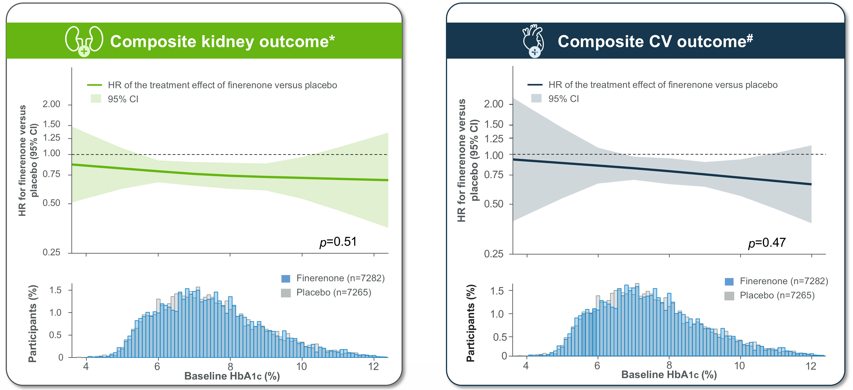
Composite kidney and composite CV outcomes across continuous baseline HbA1c levels
p=0.51
p=0.47
Histogram in the bottom panel indicates the distribution of baseline HbA1c.
*A ≥57% decrease in eGFR or kidney failure (as sustained eGFR <15 mL/min/1.73 m² or initiation of chronic dialysis or kidney transplantation); #HF hospitalisation or CV death.
CI, confidence interval; CV, cardiovascular; HbA1c, glycated hemoglobin; HF, heart failure; HR, hazard ratio.

Slide 63
Composite kidney outcome* across prespecified subgroups
Patients with an event
(n/N)
Rate/1000 PY
Subgroup
Finerenone
Placebo
Finerenone
Placebo
HR (95% CI)
p_{interaction}
eGFR, mL/min/1.73 m²
0.16
<45
293/2617
349/2613
42.8
51.5
0.85 (0.73, 0.99)
45-<60
71/1918
104/1931
13.2
19.3
0.67 (0.49, 0.90)
≥60
96/2755
136/2737
11.5
16.4
0.67 (0.51, 0.87)
UACR, mg/g
0.24
<300
40/2218
43/2155
5.6
6.3
0.88 (0.57, 1.35)
300–1000
93/2884
146/2917
11.6
17.9
0.63 (0.49, 0.82)
>1000
327/2187
400/2208
60.1
73.7
0.81 (0.70, 0.93)
SGLT2i use
0.99
Yes
30/570
39/572
18.3
24.3
0.77 (0.48, 1.23)
No
430/6721
550/6711
22.7
29.2
0.77 (0.68, 0.87)
Overall
460/7291
589/7283
22.3
28.8
0.76 (0.68, 0.86)
0.25
0.5
0.75
1.0
1.5
Favours finerenone
Favours placebo

Slide 64
Hyperkalaemia*
Patients with diabetes
Patients without diabetes
TE hyperkalaemia
TE hyperkalaemia serious AE
TE hyperkalaemia
TE hyperkalaemia serious AE
Finerenone (N=6489)
Finerenone (N=793)
Participants (%)
Placebo (N=6474)
Participants (%)
Placebo (N=791)
Any
Any
Any
Any
Leading to permanent discontinuation
Leading to hospitalisation
Leading to death
Leading to permanent discontinuation
Leading to hospitalisation
Leading to death
Mean eGFR 58 mL/min/1.73 m²
Mean eGFR 47 mL/min/1.73 m²

Slide 65
Hyperkalaemia*
Patients with diabetes
Patients without diabetes
TE hyperkalaemia
TE hyperkalaemia serious AE
TE hyperkalaemia
TE hyperkalaemia serious AE
Finerenone (N=6489)
Finerenone (N=793)
Participants (%)
Placebo (N=6474)
Participants (%)
Placebo (N=791)
Any
Any
Any
Any
Leading to permanent discontinuation
Leading to hospitalisation
Leading to death
Leading to permanent discontinuation
Leading to hospitalisation
Leading to death
Mean eGFR 58 mL/min/1.73 m²
Mean eGFR 47 mL/min/1.73 m²

Slide 66
Hyperkalaemia*
Patients with diabetes
Patients without diabetes
TE hyperkalaemia
TE hyperkalaemia serious AE
TE hyperkalaemia
TE hyperkalaemia serious AE
Finerenone (N=6489)
Finerenone (N=793)
Event rate (per 1000 PY): 3.7 vs 0.6
HR (95% CI): 6.21 (3.18, 12.12)
Event rate (per 1000 PY): 3.2 vs 2.2
HR (95% CI): 1.48 (0.47, 4.67)
Participants (%)
Placebo (N=6474)
Placebo (N=791)
Participants (%)
Any
Any
Any
Any
Leading to permanent discontinuation
Leading to hospitalisation
Leading to death
Leading to permanent discontinuation
Leading to hospitalisation
Leading to death
Mean eGFR 58 mL/min/1.73 m²
Mean eGFR 47 mL/min/1.73 m²

Slide 67
Hyperkalaemia*
Patients with diabetes
Patients without diabetes
TE hyperkalaemia
TE hyperkalaemia serious AE
TE hyperkalaemia
TE hyperkalaemia serious AE
Finerenone (N=6489)
Finerenone (N=793)
Event rate (per 1000 PY): 3.7 vs 0.6
HR (95% CI): 6.21 (3.18, 12.12)
Event rate (per 1000 PY): 3.2 vs 2.2
HR (95% CI): 1.48 (0.47, 4.67)
Participants (%)
Placebo (N=6474)
Placebo (N=791)
Participants (%)
P_{interaction}=0.0343
Any
Any
Any
Any
Leading to permanent discontinuation
Leading to hospitalisation
Leading to death
Leading to permanent discontinuation
Leading to hospitalisation
Leading to death
Mean eGFR 58 mL/min/1.73 m²
Mean eGFR 47 mL/min/1.73 m²

Slide 68
Prespecified safety outcomes
Finerenone (n=7282)
Placebo (n=7265)
Adverse events
Serious
adverse events
Patients (%)

Slide 69
Prespecified safety outcomes
Finerenone (n=7282)
Placebo (n=7265)
Adverse events
Serious
adverse events
Hypotension
Patients (%)

Slide 70
Prespecified safety outcomes
Finerenone (n=7282)
Placebo (n=7265)
Adverse events
Serious
adverse events
Hypotension
Acute kidney injury*
Patients (%)

Slide 71
Prespecified safety outcomes
Finerenone (n=7282)
Placebo (n=7265)
Adverse events
Serious
adverse events
Hypotension
Acute kidney injury*
Hypokalaemia
Patients (%)

Slide 72
Summary
This pre-specified individual patient data pooled analysis investigated the efficacy and safety of finerenone in patients with a broad range of CKD aetiologies, levels of glycaemia, and kidney function
Finerenone reduced the risk of CKD progression, including kidney failure alone, CV events, and mortality relative to placebo
Treatment effects on the composite kidney outcome were consistent across a broad spectrum of baseline glycaemia levels and kidney function and were unaffected by baseline SGLT2i use
Finerenone was well-tolerated in this broad patient population
Hyperkalaemia occurred more frequently with finerenone than placebo, but the incidence of events requiring hospitalisation was low in both arms
  The risk of hospitalisation for hyperkalaemia was increased in patients with vs without diabetes

Slide 73
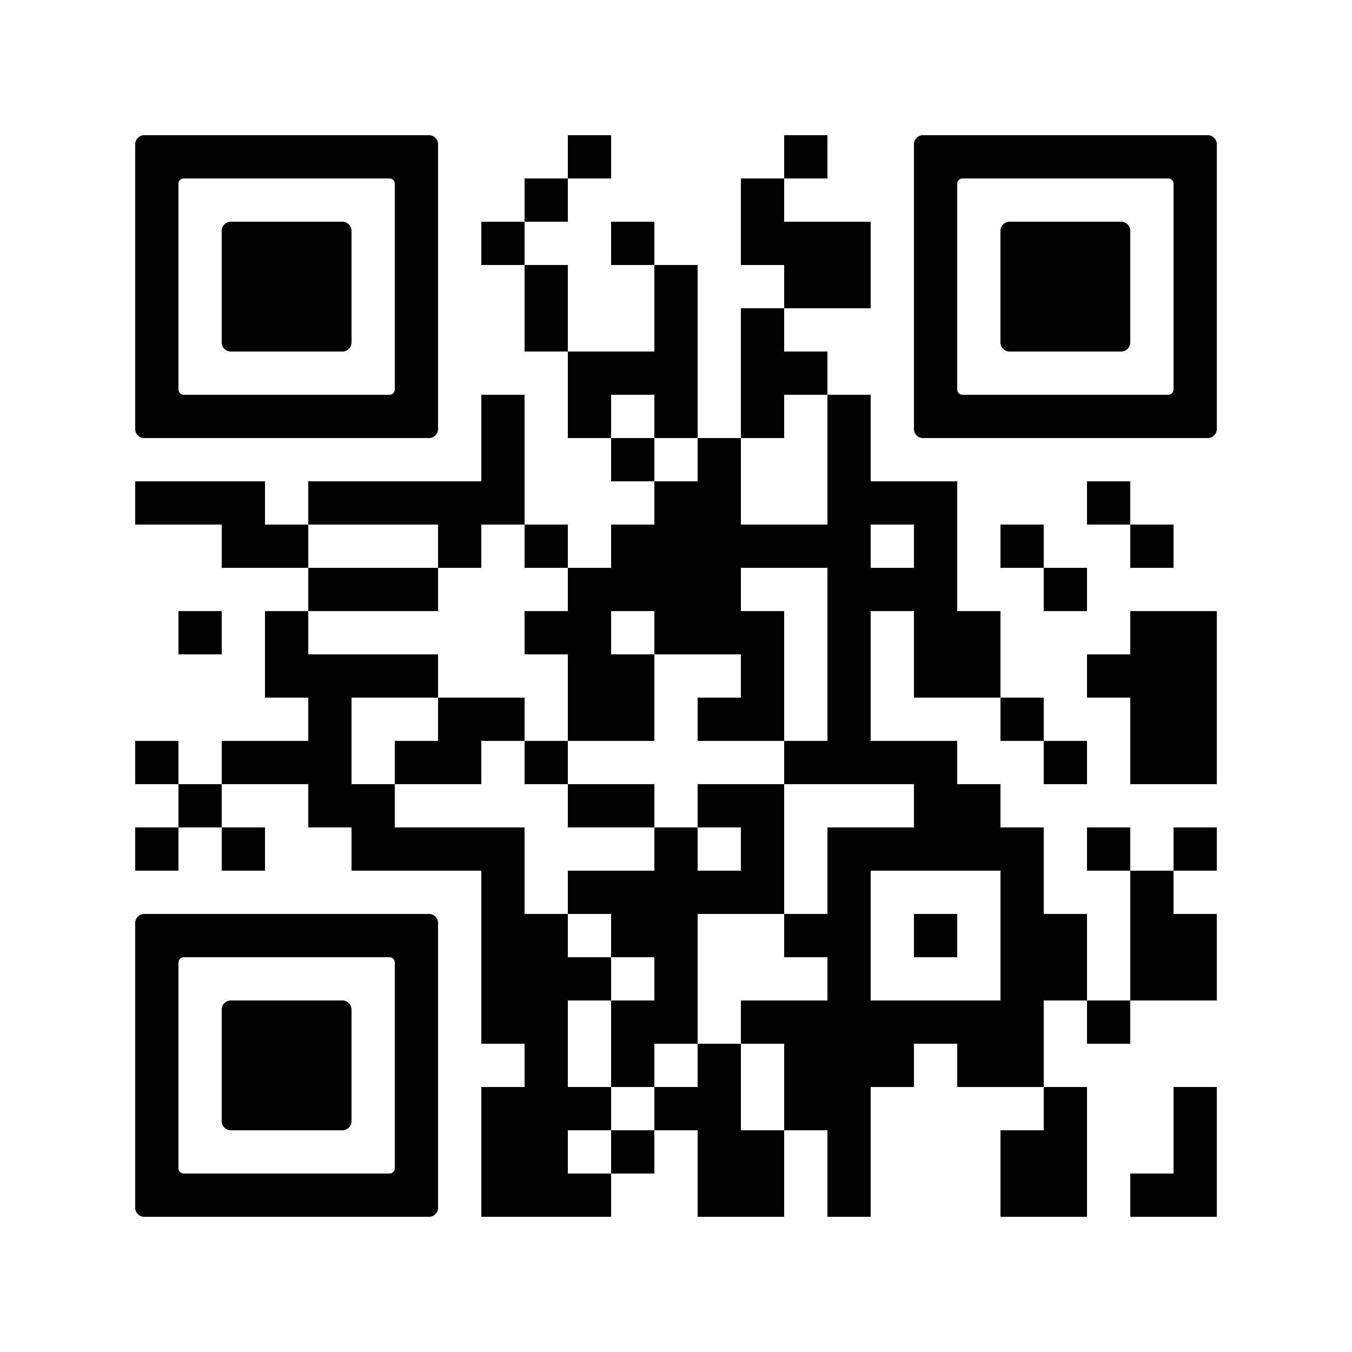

The LANCET
Aoife doing now
Brendon L Neuen, Hiddo JL Heerspink, Vlado Perkovic, et al,
and the FIND-CKD, FIDELIO-DKD and FIGARO-DKD Investigators
Efficacy and safety of finerenone in patients with chronic kidney disease: An individual participant data pooled analysis (INFINITY)
Published online June 5, 2026
European Renal Association 63rd Congress
Available at thelancet.com
Scan to read the article

Slide 74
Clinical interpretation
Katherine R. Tuttle

Slide 75
Speaker disclosures: Katherine R. Tuttle
Has received grants from NIDDK, NHLBI, NCAT, NIH Director’s Office, CDC, Breakthrough T1D, Benaroya Research Institute, Doris Duke Foundation, Travere, Bayer and Otsuka
Has received consulting fees from Alnylam, AstraZeneca, Bayer, Boehringer Ingelheim, GlaxoSmithKline, Novo Nordisk, ProKidney and Roche
Has received speaker fees from AstraZeneca, Bayer, Boehringer Ingelheim, Novo Nordisk and Travere
Has participated in an advisory board for NIDDK, George Clarke Institute and AstraZeneca
Is a chair at the Diabetic Kidney Disease Collaborative
Was a co-chair at ASN Kidney Week 2025 Program Committee
The FIND-CKD trial was funded by Bayer AG

Slide 76

CKD is a global public health crisis
Worldwide
Regional prevalence in 2023²
Extremely common
~800
MILLION
42.1 million*
82.6 million
2017–2023^{1,2}
412 million
64.1 million
Death rate in 2023²
1480 THOUSANDS
69.5 million
5th
63.6 million†
2.8 million
9th
13th
19th
~183 thousands deaths in 2023²
2040
(predicted)
2013
2016
2023
Rank in cause of death^{1,2}

Slide 77
Kidney failure, heart failure, CV death, and all-cause death
Low
Moderately increased
Very high
Risk of adverse outcome:
High
 |  | A1 | A2 | A3
 |  | 0–29 | 30–<300 | ≥300–≤5000
G1 | ≥90
G2 | 60–89
G3a | 45–59
G3b | 30–44
G4 | 15–29
G5 | <15
Albuminuria categories (mg albumin/g creatinine)
GFR categories (mL/min/1.73 m²)
FIND-CKD¹
Non-diabetic CKD (N=1584)

Slide 78


Key drivers of CKD progression
Diabetes, high protein diet, obesity, hypertension, APOL1 genotype, concurrent CKDs
Metabolic
disturbances
Haemodynamic
mediators
Inflammation and fibrosis
MR OVERACTIVATION
Histone methylation or acetylation
ROS
AGEs and SAA
Autocrine/paracrine receptor binding to:
-RAGE
-TLR-4
ROS
Gut microbiome changes
Angiotensin II
AGEs
Aldosterone
Endothelins
Inflammatory factors
Fibrotic factors
Feed-forward cycle of proinflammatory and profibrotic factor production
Kidney damage, onset and progression
AGEs, advanced glycation end-products; APOL1, apolipoprotein L1; RAGE, receptor for AGEs; ROS, reactive oxygen species; SAA, serum amyloid A; TLR-4, toll-like receptor-4.
Tuttle KR et al. Kidney International 2022;102:248–260.
78

Slide 79
Why does eGFR slope matter?
FIND-CKD
FIDELIO-DKD
DAPA-CKD
EMPA-KIDNEY
Finerenone
Finerenone¹
Dapagliflozin²
Empagliflozin³
Finerenone
Dapagliflozin
Empagliflozin
Placebo
0.7
mL/min/1.73 m²/year
(95% CI, 0.3, 1.1)
0.7
mL/min/1.73 m²/year
(95% CI, 0.4, 0.9)
0.5
mL/min/1.73 m²/year
(95% CI, -0.1, 1.0)
0.6
mL/min/1.73 m²/year
(95% CI, 0.3, 0.9)

Slide 80
Composite kidney-CV outcome*
30
Hazard ratio, 0.77
(95% CI, 0.60, 0.99)
p=0.043
Placebo
No. of participants with event: 134 (16.9%)
n per 100 PY (95% CI): 5.8 (4.9, 6.9)
25
20
15
Cumulative incidence (%)
10
5
Finerenone
No. of participants with event: 110 (13.9%)
n per 100 PY (95% CI): 4.7 (3.9, 5.6)
0
0
3
6
9
12
16
20
24
28
32
36
40
44
Months since randomisation
At risk (n)
Placebo | 791 | 782 | 778 | 766 | 755 | 744 | 731 | 714 | 680 | 624 | 429 | 253 | 124
Finerenone | 793 | 786 | 777 | 767 | 753 | 735 | 724 | 708 | 688 | 639 | 471 | 305 | 152

Slide 81
Kidney, CV, and mortality outcomes
Events
Event rate/1000 PY
Outcome
Finerenone
(N=7291)
Placebo
(N=7283)
Finerenone
Placebo
Hazard ratio (95% CI)
p-value
Kidney outcomes
Kidney failure or sustained ≥57% decrease in eGFR
460
589
22.3
28.8
0.76 (0.68, 0.86)
<0.0001
Kidney failure, sustained ≥57% decrease in eGFR, or CV death
612
763
29.7
37.3
0.79 (0.71, 0.88)
<0.0001
Kidney failure, sustained ≥57% decrease in eGFR,
HF hospitalisation, or CV death
786
997
38.6
49.6
0.77 (0.70, 0.85)
<0.0001
Kidney failure*
346
399
16.7
19.4
0.85 (0.74, 0.99)
0.0302
Dialysis or kidney transplantation
189
240
8.5
10.9
0.77 (0.64, 0.94)
0.0089
0.5 0.75
1
1.5
Favours
finerenone
Favours
placebo

Slide 82
Kidney, CV, and mortality outcomes
Events
Event rate/1000 PY
Outcome
Finerenone
(N=7291)
Placebo
(N=7283)
Finerenone
Placebo
Hazard ratio (95% CI)
p-value
Kidney outcomes
Kidney failure or sustained ≥57% decrease in eGFR
460
589
22.3
28.8
0.76 (0.68, 0.86)
<0.0001
Kidney failure, sustained ≥57% decrease in eGFR, or CV death
612
763
29.7
37.3
0.79 (0.71, 0.88)
<0.0001
Kidney failure, sustained ≥57% decrease in eGFR,
HF hospitalisation, or CV death
786
997
38.6
49.6
0.77 (0.70, 0.85)
<0.0001
Kidney failure*
346
399
16.7
19.4
0.85 (0.74, 0.99)
0.0302
Dialysis or kidney transplantation
189
240
8.5
10.9
0.77 (0.64, 0.94)
0.0089
CV outcomes
HF hospitalisation
263
334
12.0
15.3
0.78 (0.66, 0.92)
0.0024
HF hospitalisation or CV death
420
520
19.1
23.9
0.80 (0.70, 0.91)
0.0006
0.5 0.75
1
1.5
Favours
finerenone
Favours
placebo

Slide 83
Kidney, CV, and mortality outcomes
Events
Event rate/1000 PY
Outcome
Finerenone
(N=7291)
Placebo
(N=7283)
Finerenone
Placebo
Hazard ratio (95% CI)
p-value
Kidney outcomes
Kidney failure or sustained ≥57% decrease in eGFR
460
589
22.3
28.8
0.76 (0.68, 0.86)
<0.0001
Kidney failure, sustained ≥57% decrease in eGFR, or CV death
612
763
29.7
37.3
0.79 (0.71, 0.88)
<0.0001
Save kidneys, save hearts, save lives.
Kidney failure, sustained ≥57% decrease in eGFR,
HF hospitalisation, or CV death
786
997
38.6
49.6
0.77 (0.70, 0.85)
<0.0001
Kidney failure*
346
399
16.7
19.4
0.85 (0.74, 0.99)
0.0302
Dialysis or kidney transplantation
189
240
8.5
10.9
0.77 (0.64, 0.94)
0.0089
CV outcomes
HF hospitalisation
263
334
12.0
15.3
0.78 (0.66, 0.92)
0.0024
HF hospitalisation or CV death
420
520
19.1
23.9
0.80 (0.70, 0.91)
0.0006
Mortality outcome
CV death
182
220
8.1
9.9
0.82 (0.67, 0.999)
0.0489
All-cause death
569
642
25.4
28.8
0.88 (0.79, 0.99)
0.0261
0.5 0.75
1
1.5
Favours
finerenone
Favours
placebo

Slide 84
Treatment paradigm in diabetic and non-diabetic kidney disease
Diabetic
kidney disease
Non-diabetic
kidney disease
Aetiology-specific therapies
RASi
SGLT2i
Finerenone
GLP-1RA
RASi
SGLT2i
Finerenone
Other treatments?
Comprehensive lifestyle and risk factor modification
Additive benefits
Addressing multiple disease mechanisms
Larger anticipated improvements in albuminuria and eGFR decline
Enhanced heart protection

Slide 85




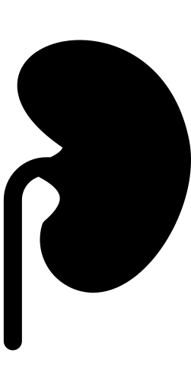

Take home points
!
CKD remains common and deadly
Highly effective therapies including RAS inhibition, SGLT2 inhibition, and finerenone reduce major kidney and CV risks in broad CKD populations
FIND-CKD and INFINITY have demonstrated clinically relevant benefit for finerenone to improve kidney, CV, and survival outcomes regardless of diabetes in people with CKD
CKD awareness, detection, and timely interventions are urgently needed to preserve kidney and heart function, and save lives for millions of people worldwide

Slide 86
Q&A
Vlado Perkovic

Slide 87



QR code placeholder
Design and baseline characteristics of the FIND-CKD randomized trial
Efficacy and safety of finerenone in patients with chronic kidney disease: an individual participant data pooled analysis (INFINITY)
Finerenone in persons with chronic kidney disease
without diabetes
Finerenone in patients with chronic kidney disease due to glomerular diseases

Slide 88
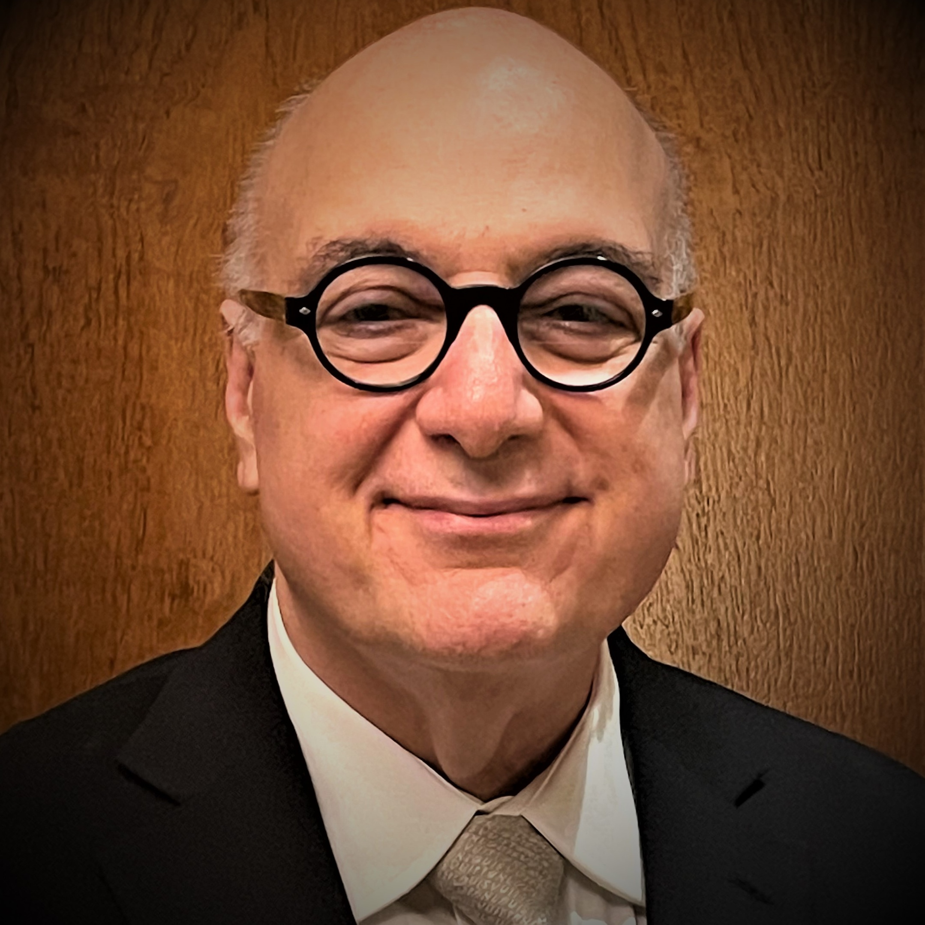
Thank you
The FIND-CKD teams would like to thank all
participating patients and their families
We would also like to thank:
Steering committee
Hiddo J.L. Heerspink (the Netherlands), Brendon L. Neuen (Australia), Rajiv Agarwal (USA), David Z.I. Cherney (Canada), Carolyn S.P. Lam (Singapore), Katherine R. Tuttle (USA), Christoph Warner (Germany), Vlado Perkovic (Australia)
We would like to acknowledge the late George L. Bakris, esteemed FIND-CKD steering committee member, who passed away in June 2024
The authors thank him for his invaluable contribution to the design and conduct of this trial
He will be remembered for his passion for science and patient care
Data monitoring committee
Glenn M. Chertow (USA), Murray Epstein (USA), Tim Friede (Germany), Adeera Levin (Canada), Johannes F.E. Mann (Germany)
Investigators
National lead investigator coordinator:
Panteleimon (Pantelis) Sarafidis
Argentina
Rafael Maldonado (national lead), Paola Aguerre, Paula Arenas, Mariano Arriola, Claudia Emilce Baccaro, Maria Bevilacqua, Julio Bittar, Dafne Brodschi, Julia Caceres, Gina Campestri, Maria Cecilia Cantero, Santiago Cardona, Florencia Casan, Evelin Cassini, Gustavo Catalano, Mariano Chahin, Natalia Cluigt, Ana Florencia Comes, Pamela Delgado, Maria Paula Dionisi, Silvina Dominguez, Rocio Fernandez, Elizabeth Gelersztein, Sandra Giacometti, Diego Andres Mohr Gosparini, Fernando Pedro Guerlloy, Fernando Halac, Miguel Angel Hominal, Cecilia Igarzabal, Veronica Lacoste, Micaela Leis, Pablo Martinez, Virginia Rama, Lucia Rodriguez, Silvia Rodriguez, Luciana Rovegno, Benjamin Saenz, Maria Victoria Sobredo, Matias Suarez, Patricia Varela, Guido Villalobo, Sernia Virginia, Diego Waserman, Daniela Magali Zaccaro, Javier Zaidman
Australia
David Packham (national lead), Sunil Badve, Melissa Cheetham, Jenny Chen, Kathryn Ducharlet, Dov Degen, Yusuf Eqbal, Adam Flavell, Celine Foote, Nicholas Gray, Carmel Hawley, Peter Hollett, Jane Holt, Louis Huang, Nicole Isbel, Dev Jegatheesan, Rathika Krishnasamy, Christina Lai, Cathie Lane, Darren Lee, Kumaradevan Mahadevan, George Mangos, Euan Noble, Eugenia Pedagogos, Mona Razavian, Angus Ritchie, Matthew Roberts, Kate Robson, Shaundeep Sen, Amanda Wang, Jane Waugh, Muh Geot Wong, Lucy Wynter
Belgium
Marijn Speeckaert (national lead), Bert Bammens, Kathleen Claes, Marc Decupere, Katrien De Vusser, Bernard Dubois, Peter Doubel, Pieter Evenepoel, Michel Jadoul, Francois Jouret, Laura Labriola, Laura Labriola, Bart Maes, Thomas Malfait, Gert Meeus, Bjorn Meijers, Maarten Naesens, Olivier Schockaert, Wim Van Biesen, Amaryllis Van Craenenbroeck, Elliott Van Regemorter, An Vanacker, Liesbeth Viaene
Bulgaria
Svetla Stamova (national lead), Gencho Arabadzhiev, Lachezar Atanasov, Stela Bilcheva, Christo Dimitrov, Irena Dimitrova, Ivan Georgiev, Ivan Gerchev, Lyubomir Hristov, Veselin Hristozov, Stefan Ilchev, Georgi Ivanov, Yordanka Ivanova, Boyka Ivanova-Terzieva, Kostadin Kichukov, Neli Koleva, Georgi Lichev, Ginka Marinova-Racheva, Georgi Mazhdrakov, Ismed Mehmedov, Lora Nikolova, Iliev Rumen, Plamen Pelov, Rositsa Petrova, Blagovest Stoimenov, Galina Stoyanova, Velina Stoyanova, Vladislava Todorova, Vasil Tsenov, Albena Vasileva, Daniela Vasileva, Liliya Vasileva-Boyadzhieva, Tsvetelina Vutova, Tundzhay Yuztyurk, Vladimir Zhelev
China
Xiangmei Chen (national lead), Yelixiati Adelibieke, Jianxiang Bai, Weijing Bian, Kedan Cai, Yuan Cai, Jingyuan Cao, Lingxiong Chai, Suolinge Chahan, Xuejing Chang, Hong Cheng, Jinxiu Cheng, Bo Chen, Chaosheng Chen, Cheng Chen, Jia Chen, Lianhua Chen, Long Chen, Menghua Chen, Qingping Chen, Qinkai Chen, Ruixue Chen, Weidong Chen, Xing Chen, Xinghua Chen, Yihua Chen, Caixia Cui, Shuang Cui, Yingchun Cui, Xiaokai Ding, Xiaoqiang Ding, Junwu Dong, Liping Dong, Xiangnan Dong, Juan Du, Xingguo Du, Weifeng Fan, Ming Fang, Xiaonan Feng, Yingzhou Geng, Wenyu Gong, Yingli Gu, Yuzhen Guan, Liming Guo, Ling Guo, Qiaoyan Guo, Tingting Guo, Ziwei Guo, Sailaiajimu Guzailinuer, Dapeng Hao, Yaning Hao, Qin He, Weiming He, Xiaoquan He, Yani He, Xianghua Hou, Haiyun Hu, Jijia Hu, Ping Hu, Weiping Hu, Yanping Hu, Chengwen Huang, Qianyin Huang, Shengling Huang, Wenjing Huang, Gengru Jiang, Chonggao Jia, Yonghong JIan, Li Jin, Bing Li, Hua Li, Jianfei Li, Jiefeng Li, Jing Li, Li Li, Lu Li, Minxia Li, Peilin Li, Peng Li, Qing Li, Shenheng Li, Wei Li, Wenge Li, Yinan Li, Youqi Li, Yuehong Li, Zengyan Li, Hongqing Liang, Wei Liang, Yaojun Liang, Hongli Lin, Kexuan Lin, Yongqiang Lin, Bicheng Liu, Chunxiao Liu, Cuilan Liu, Dan Liu, Fang Liu, Fanna Liu, Feng Liu, Guangyi Liu, Hongyan Liu, Hua Liu, Lei Liu, Longhui Liu, Qiong Liu, Shengjun Liu, Siyi Liu, Yu Liu, Zhifen Liu, Gang Long, Haibo Long, Yinhua Long, Bingpeng Lu, Wanhong Lu, Xuehong Lu, Congwei Luo, Ping Luo, Qun Luo, Xia Lv, Yinqiu Lv, Xue Ma, Xiaoyan Meng, Li Ni, Lin Ning, Dan Niu, Jianying Niu, Xing Pan, Yan Pan, Fenfen Peng, Chunmei Qin, Haiao Qin, Wenxian Qiu, Weidong Ren, Zhilong Ren, Zhakeer Rexidan, Weifeng Shang, Sinan Shao, Shujun Shi, Xuan Shi, Yanling Shi, Yongjun Shi, Baolin Su, Bofeng Su, Ke Su, Wenxue Sun, Xuejuan Sun, Yanbei Sun, Shuifu Tang, Xun Tang, Yingqian Tang, Yufeng Tang, Yuyan Tang, Qianru Tao, Ming Tian, Haitao Tu, Yan Tu, Jingfang Wan, Baoan Wang, Caili Wang, Dao Wang, Deguang Wang, Fang Wang, Fengmei Wang, Fengyun Wang, Hong Wang, Jialin Wang, Jianqin Wang, Kaiyue Wang, Lailiang Wang, Linlin Wang, Rui Wang, Ruifeng Wang, Shuyun Wang, Xiaoling Wang, Xuerong Wang, Ya Wang, Ying Wang, Yu Wang, Zengsi Wang, Zhigang Wang, Honglan Wei, Xiansen Wei, Zhifeng Wei, Zhongping Wei, Chaoqing Wu, Guangfu Wu, Guanmin Wu, Min Wu, Qing Wu, Shukun Wu, Xueping Wu, Yang Wu, Yuou Xia, Qijing Xian, Xiaoyan Xiao, Fei Xiong, Li Xiang, Boyang Xu, Feng Xu, Huiying Xu, Jia Xu, Junfu Xu, Lingcang Xu, Qianqian Xu, Xudong Xu, Yan Xu, Xiaotong Xie, Bing Yan, Jin Yan, Rui Yan, Aicheng Yang, Dingping Yang, Jie Yang, Min Yang, Xiangdong Yang, Yan Yang, Yansong Yang, Qi Yao, Nan Ye, Xiaohan You, Chuanqi Yu, Jinbo Yu, Manshu Yu, Tianyu Yu, Xiaoyang Yu, Ying Yu, Yi Yu, Jun Yuan, Li Zeng, Rong Zeng, Chong Zhang, En Zhang, Han Zhang, Huidi Zhang, Ji Zhang, Jianna Zhang, Jiong Zhang, Jingjing Zhang, Jun Zhang, Li Zhang, Mengyu Zhang, Min Zhang, Xiaobo Zhang, Xiaoyan Zhang, Yanmin Zhang, Jing Zhao, Yuancheng Zhao, Zhirui Zhao, Le Zheng, Min Zheng, Qingfa Zheng, Ying Zheng, Yu Zhong, Fangfang Zhou, Hua Zhou, Weidong Zhou, Xiaoling Zhou, Yan Zhou, Haoshen Zhu, Ya Zhuge, Li Zhuo, Chunbo Zou, Guming Zou, Jun Zou, Yun Zou, Yurong Zou
Czech Republic
Martin Prazny (national lead), Petr Bucek, Karolina Chadimova, Petra Divacka, Lucie Fantova, Marika Goluchova, Lucie Hornova, Martin Lukac, Maria Majernikova, Jiri Matuska, Helena Mrlianova, Jitka Pecirkova, Jitka Rehorova, Jan Senitko, Jan Skrha, Sarka Svobodova, Svetlana Vankova,
Marek Weiss, Jan Wirth
Denmark
Mads Hornum (national lead), Jesper Bech, Iain Bressendorf, Peter Clausen, Stine Louise Høyer Finsen, Sabina Chaudhary Hauge, Ditte Hansen, Gitte Rye Hinrichs, Claus Bogh Juhl, Dea Kofod, Morten Lindhardt, Ebba Elisabeth Mannheimer, Frank Holden Mose, Line Aaes Mortensen, Karin Brochner Ostergaard, Ida Maria Hjelm Soerensen, Marie Abildgaard Tolstrup
Greece
Evangelos Papachristou (national lead), Atalla Alexandros, Maria-Eleni Alexandrou, Dimitrios Apostolakis, Karmen Armetzioiou, Gerasimos Bamichas, Christos Bantis, Marianna Bakou, Ioannis Boletis, Margarita Bora, Adamantia Bratsiakou, Aglaia Chalkia, Kleio Eleftheria Dermitzaki, Chrysostomos Dimitriadis, Eleni Drosataki, Anila Duni, Melani Erotokritou, Stylianos Fragkidis, Michael Garoufis, Panagiotis Giamalis, Dimitrios Goumenos, Chariklia Gouva, Athanasia Kapota, Achillefs Karras, Georgios Alexandros Kavvadias, Theodora Kouloukourgiotou, Parthena Kyriklidou, Anna Loli, Aikaterini Lysitska, Ioannis Mallioras, Eleni Manou, Smaragdi Marinaki, Efstathios Mitsopoulos, Anna Mountzourogeorgou, Alexandra Ntemka, Evangelia Ntounousi, Dorothea Papadopoulou, Aikaterini Papagianni, Michalis Papapanagiotou, Marios Papasotiriou, Stella Paschou, Panagiotis Pateinakis, Ioannis Petrakis, Dimitrios Petras, Panteleimon (Pantelis) Sarafidis, Chrysanthi Skalioti, Maria Smyrli, Georgios Spanos, Maria Stangou, Konstantinos Stylianou, Maria Panagiota Theodorakopoulou, Ioanna Theodorou, Maria Triantafyllidou, Ioannis Tsouchnikas, Kalliopi Vallianou, Efstathios Xagas
Hong Kong
Sydney Chi Wai Tang (regional lead), Anthony Ting Pong Chan, Gary Chi Wang Chan, Au Cheuk, Samuel Ka Shun Fung, Lorraine Pui Yuen Kwan, Kit Ming Lee, William Lee, Victor Li, Davina Ngoi Wah Lie, Sing Leung Lui, Jack Kit Chung Ng, Cheuk Chun Szeto, Arthur Ho Cheung Tang, Hon Lok Tang, Jeffrey Tsun Wai Wu, Jessica Man Ka Yeung
Hungary
Laszlo Kovacs (national lead), Gabriella Bencze, Hocine Boulellou, Dora Csaplaros, Szilvia Csitneki, Paula Endredy, Robert Kirschner, Tibor Kovacs, Aniko Nemeth, Tamas Szelestei, Tamas Szalay, Istvan Wittmann, Peter Zilahi, Zsolt Zilahi
India
Sanjay Agarwal (national lead), Susanne Nicholas (diversity lead), Nagesh Aghor, Alan Almeida, Venkatesh Arumugam, Subbiah Arunkumar, Gagan Deep Chhabra, Ayan Dey, Kunal Gandhi, Natarajan Gopalakrishnan, Noble Gracious, Avinash Ignatius, Saurabh Khiste, Dinesh Khullar, Aparna Kodre, VR Krishnakumar, Tanuj Moses Lamech, Siddharth Mavani, Atanu Pal, Rajendra Pandey, Sakthirajan Ramanathan, Manisha Sahay, Rakesh Sahay, Patil Sandesh, Mayank Shah, Rakesh Shinde, Rasika Sirsat, Devika SL, Bagchi Soumita, Jadhav Swapnil, Dineshkumar Thanigachalam, Akshay V
Israel
Benaya Rozen-Zvi (national lead), Nabil Abu-Amer, Wafiq Amon, Ashraf Badran, Daphna Bar-Nur, Anna Basok, Orit Kliuk-Ben Bassat, Illia Beberashvili, Pazit Beckerman, Sydney Ben Chetrit, Keren Cohen-Hagai, Naomi Ben Dor, Ray Biton, Gil Chernin, Ismail El Sayed, Evgeny Farber, Raed Gantus, Anam Hanut, Michael Hausmann, Yosef Haviv, Yuval Horwich, George Jeiris, Ze'ev Katzir, Raisa Kazarsky, Yael Kenig, Irina Kenis, Avital Angel Korman, Etty (Esther) Kruzel-Davila, Olga Lesya Kukuy, Larissa Lebedev, Adi Leiba, Ronen Levi-Varadi, Nomy Levin-Iaina, Anna Mikhlin, Sharon Mini-Goldberger, Valeria Morduhovich, Naomi Nacasch, Chen Oren, Husman Qasim, Ilan Rahmani Tzvi Ran, Vladimir Rapoport, Michal Raz, Irena Rubinchik, Marina Sapojnikov, Tomer Scheib, Doron Schwartz, Mahran Shalaata, Pavel Sheinberg, Marina Tchircov, Olga Vdovich, Marina Vorobiov, Alexander Wechsler, Yoram Yagil, Teuta Zeitun
Italy
Roberto Minutolo (national lead), Valeria Aiello, Tino Paolo Ambrosino, Rocco Baccaro, Graziana Battini, Giada Bigatti, Francesca Giovanna Boni, Serena Bruno, Irene Capelli, Gianni Cappelli, Francesca Maria Ida Carminati, Roberto Cimino, Irene Colombini, Francesco Cosa, Eleonora Cristini, Erica Daina, Marco Delsante, Gabriele Donati, Ciro Esposito, Vittoria Esposito, Enrico Fiaccadori, Annachiara Ferrari, Aldo Franculli, Stefania Giberti, Barbara Gidaro, Ilaria Ida Giordano, Giuseppe Grandaliano, Maria Cristina Gregorini, Carlo Maria Guastoni, Francesca Guglielmi, Aneliya Parvanova Ilieva, Gaetano La Manna, Sarah Lerario, Maria Elena Liberti, Raul Mancini, Antonio Marino, Carlo Minicucci, Benedetta Morda, Niccolo Morisi, Elisa Olivo, Chiara Paccagnella, Maria Chiara Pacchiarini, Andrea Palladini, Rodolfo Fernando Rivera, Laura Rimoldi, Gennaro Santorelli, Renato Savino, Roberta Scarmignan, Anna Scrivo, Giuseppe Sileno, Enrico Tinti, Matias Trillini, Anna Vella
Japan
Masaomi Nangaku (national lead), Eriko Abe, Keisuke Abe, Kenichiro Abe, Masanori Abe, Taisei Abe, Shohei Adachi, Shinji Ako, Hiroaki Amano, Morimasa Amemiya, Daiki Aomura, Kunii Ayana, Kengo Azushima, Kenji Baba, Seishiro Baba, Ayako Ban, Yuki Beppu, Kyoji Chiba, Rieko China, Ichikawa Daisuke, Masayuki Ebihara, Yu Eto, Fumika Fujii, Mako Fujii, Naohiko Fujii, Tetsuro Fujii, Yusuke Fujii, Miho Fujimura, Kiichiro Fujisaki, Mikoto Fujishiro, Masako Fujita, Yoshiro Fujita, Masafumi Fukagawa, Kei Fukami, Yusuke Fukao, Daichi Fukaya, Yoshinobu Fuke, Hiromitsu Fukuda, Natsuki Fukuda, Shungo Fukuda, Yuriko Fukuda, Kanako Fukuhara, Yuichiro Fukuhara, Kento Fukumitsu, Akihiro Fukuoka, Rika Furuta, Fumihiko Furuya, Tomohito Gohda, Kento Goto, Shunsuke Goto, Ryota Haga, Junichiro Hagita, Takayuki Hamano, Satoshi Hamanoue, Tomoya Hamashoji, Akinori Hara, Kenji Harada, Makoto Harada, Koji Hashimoto, Takuto Hayakawa, Masato Hayashi, Seiichiro Hemmi, Yuji Hidaka, Fujii Hideki, Nishida Hidenori, Nishida Hidenori, Rieko Higashide, Shinichi Higuchi, Toshiyuki Hirai, Akira Hirano, Sae Hirata, Hitomi Hirose, Tatsuki Hirose, Hiroto Hiyamuta, Ryoko Honda, Keisuke Horikoshi, Shu Horikoshi, Taro Hoshino, Fumitaka Ihara, Hiroki Ikai, Eri Ikeda, Megumi Ikeda, Yoichiro Ikeda, Kaho Ikeshita, Atsuhiro Imono, Kou Imoto, Motoki Inoue, Natsumi Inoue, Tsutomu Inoue, Keita Inui, Shinichiro Irie, Kohei Ishiga, Tomomi Ishihara, Masao Ishii, Masao Ishii, Toshihisa Ishii, Masanori Ishizaka, Toshinori Ishizuka, Rina Isohata, Akiko Itano, Seiji Itano, Daisuke Ito, Kenji Ito, Sadatoshi Ito, Yuki Ito, Yuto Ito, Ryohei Iwabuchi, Tsukasa Iwakura, Tamio Iwamoto, Keita Iwasaki, Masako Iwasaki, Yasunori Iwata, Manabu Kado, Hiroyuki Kadoya, Eriko Kajimoto, Mayuri Kambayashi, Yuji Kamijo, Ayaka Kamio, Daisuke Kanai, Genta Kanai, Hidetoshi Kanai, Tomohiko Kanaoka, Takayuki Kanbe, Eiichiro Kanda, Hidetoshi Kaneoka, Takuya Kanno, Yoshihiko Kanno, Chika Kano, Rika Kasahara, Rina Kasai, Naoki Kashihara, Naoki Kashihara, Takahisa Kasugai, Arisa Kato, Miku Kato, Kyogo Kawada, Yuki Kawai, Masato Kawakami, Keiko Kawasaki, Takaaki Kawata, Okamoto Kazuhiro, Kengo Kidokoro, Masao Kihara, Satoru Kimura, Shunta Kimura, Yuta Kimura, Sho Kinguchi, Seiji Kishi, Yukari Kishima, Kiyoki Kitagawa, Maki Kitai, Shinji Kitajima, Shunsuke Kitamura, Hiroki Kobayashi, Midori Kobayashi, Ryu Kobayashi, Taiga Kobayashi, Takashi Kobayashi, Tatsuya Kobayashi, Hirokazu Koda, Tatsumi Kodama, Kaori Kohatsu, Shigehisa Koide, Gakuou Koizumi, Masahiro Koizumi, Maiko Kokubu, Waka Kokuryo, Hirotaka Komaba, Shiro Komiya, Megumi Kondo, Tatsuo Kondo, Makiko Konishi, Keiji Kono, Takeo Koshida, Hitoshi Kotake, Yoshiaki Kozaki, Motoyasu Kurahashi, Fumiko Kuwahara, Mingfeng Lee, Yoshitaka Maeda, Masayuki Maiguma, Murakoshi Maki, Yuichiro Makita, Yuko Makita, Yamamoto Marumi, Takashi Maruyama, Akihiro Masaki, Kosuke Masutani, Daisuke Matsui, Masaru Matsui, Noriaki Matsui, Hidenobu Matsumoto, Keiichiro Matsumoto, Hana Matsuoka, Hiroki Matsuoka, Yuki Matsuura, Imari Mimura, Taichiro Minami, Tomomi Minamisawa, Taro Misaki, Soichiro Misegawa, Yoei Miyabe, Taro Miyagawa, Kanyu Miyamoto, Yoshitaka Miyaoka, Hitoshi Miyasato, Takanori Miyazaki, Rinsaku Miyazawa, Masashi Mizuno, Masashi Mizuno, Masato Mizuta, Anri Mori, Daisuke Mori, Katsuo Mori, Rieko Morita, Ryutaro Morita, Takahito Moriyama, Yukari Murai, Miho Murashima, Yusuke Murata, Takanori Muta, Masahiro Muto, Yuna Muto, Miho Nagai, Yoshiro Nagano, Ai Nagasawa, Fumika Nagase, Koya Nagase, Ai Nagashima, Hajime Nagasu, Katsuyuki Nagatoya, Masahiro Nakagaki, Saeko Nakagawa, Shiori Nakagawa, Yosuke Nakagawa, Yusuke Nakamata, Megumi Nakamura, Yoshihiro Nakamura, Yuki Nakamura, Yutaka Nakano, Satsuki Nakashita, Junichiro Nakata, Izaya Nakaya, Maiko Nakayama, Yuki Nakayama, Ayaka Nambu, Yuta Namiki, Yuki Naruse, Hiroko Nawata, Masuyuki Nawata, Yoshihito Nihei, Takayuki Nimura, Hiroshi Nishi, Shinichi Nishi, Marina Nishikawa, Takahiko Nobuoka, Ayumi Noda, Keita Noda, Hiroki Nomi, Ayumu Nomizu, Akihiro Nomura, Naohiro Nosho, Arisa Nozaki, Shintaro Ochiai, Aiko Oda, Riku Oda, Tomomi Ogasa, Akihiro Ogawa, Hidetaka Oguma, Hisayuki Ogura, Yoshitatsu Ohara, Atsuki Ohashi, Kohji Ohki, Kohei Ohori, Hirokazu Okada, Eimei Okamoto, Hirofumi Okamoto, Kazuhiro Okamura, Masahiro Okamura, Nozomi Okamura, Go Okanishi, Jun Okita, Kie Okoshi, Ayako Okuno, Minamo Ono, Sumihisa Ono, Kiyomi Osako, Keiichi Osano, Jin Oshikawa, Megumi Oshima, Tadashi Oshita, Jun Ota, Yoshito Otomo, Tomoyuki Otsuka, Junji Oyama, Shingo Ozaki, Moe Ozawa, Toshikazu Ozeki, Kitaoka Reo, Tetsuro Rikihisa, Mizuho Saeki, Midori Saito, Rina Saito, Suguru Saito, Takahiro Saito, Sanae Saka, Norihiko Sakai, Kazuo Sakamoto, Tsutomu Sakurada, Sho Sasaki, Tamaki Sasaki, Yasunori Sasaki, Yuya Sasatsuki, Junichi Sato, Koichi Sato, Koji Sato, Yoshiki Sato, Yuichi Sato, Yuichiro Sawada, Shoji Sawaki, Yumika Seki, Yugo Shibagaki, Maki Shibata, Motoko Shimada, Yuji Shimada, Sho Shimamoto, Norisuke Shimamura, Hideaki Shimizu, Mao Shimizu, Masatoshi Shimizu, Miho Shimizu, Yoshitaka Shimizu, Sayuri Shirai, Yoshida Shun, Keisuke Soeda, Jun Soma, Wataru Sone, Yusuke Sonezaki, Mari Sotozawa, Hiroshi Suga, Mai Sugahara, Ayaka Sugimachi, Michihisa Sugita, Yusuke Sumitani, Hiroshi Suwa, Yumi Suwa, Hitoshi Suzuki, Satoshi Suzuki, Yusuke Suzuki, Kazuhiro Tada, Yuka Tadanawa, Genri Tagami, Takashi Taguchi, Miyuki Takagi, Hisatsugu Takahara, Kazuya Takahashi, Koji Takahashi, Jun Takami, Hiroyuki Takashima, Taisuke Takatsuka, Yuri Takeda, Miyoshi Takeuchi, Riku Takeuchi, Masaaki Takizawa, Naoho Takizawa, Shinjiro Tamai, Yoshihiko Tamayama, Koichi Tamura, Misumi Tamura, Yasuhisa Tamura, Shin Tanaka, Shohei Tanaka, Tetsuhiro Tanaka, Yuki Tanaka, Yohei Taniguchi, Haruna Tanoue, Kosuke Tansho, Rie Tatsugawa, Ryoma Tatsumoto, Ritsukou Tei, Yumi Tobari, Masayoshi Toda, Takayuki Toda, Maho Tokuchi, Saori Tomita, Tatsuya Tomonari, Koji Tomori, Kano Toshiki, Tomoyuki Toya, Yoshiyuki Toya, Tadashi Toyama, Mariko Toyoda, Kazuki Toyota, Koki Tsubota, Shunichiro Tsukamoto, Hideo Tsushima, Kohei Uchimura, Eiko Ueda, Seiji Ueda, Shun Ueda, Reina Umeno, Yukako Umezawa, Shingo Urate, Masafumi Wada, Takashi Wada, Takehiko Wada, Yoshihisa Wada, Hiromichi Wakui, Naoko Waseda, Mizuki Watada, Kentaro Watanabe, Shiika Watanabe, Tsuyoshi Watanabe, Yuki Watanabe, Yusuke Watanabe, Haruka Yabuta, Aiko Yamada, Koshi Yamada, Shigehiro Yamada, Yosuke Yamada, Kosuke Yamaka, Eriko Yamamoto, Koichiro Yamamoto, Mari Yamamoto, Masako Yamamoto, Toshiya Yamamoto, Yuta Yamamura, Takahiro Yamanaka, Masatomo Yamane, Satoshi Yamane, Ayaka Yamanishi, Yu Yamanouchi, Atsushi Yamauchi, Ryo Yasuhara, Tetsuhiko Yasuno, Masahiko Yazawa, Masakazu Yoda, Yuki Yokoyama, Sayoko Yonemoto, Hiroki Yoshida, Yoshinori Yoshida, Shiori Yoshimura, Masabumi Yoshino, Yuri Yoshitake, Takahiro Yuasa, Jun Yuto
Malaysia
Wan Ahmad Hafiz Wan Md Adnan (national lead), Nur Nadzifah Hanim Zainal Abidin, Mohd Kamil Ahmad, Nuzaimin Hadafi Ahmad, Norzawati Ali, Wan Ahmad Syahril Rozli Wan Ali, Kavitha Appava, Azrini Abdul Aziz, Alia Zubaidah Bahtar, Sunita Bavanandam, Chee Eng Chan, Meng Lee Chang, Chang Chuan Chew, Chia Ling Chew, Chee Loong Chong, Sarah Qian Rou Choo, WenJet Choong, Loo Han Chuan, Sun Quan Ee, Fareeza Hawani Muhamad Fawzi, Zher Lin Go, Subasni Govindan, Siti Hafizah Mohammad Ismail, Muhamad Ali Sk Abdul Kader, Huan Yean Kang, Nurnadiah Kamarudin, Sujesthra Rao Krishnamurthy, Kesavathy Krishnan, Aik Kheng Lee, Kai Quan Lee, Li Yuan Lee, Sue Ann Lee, Yee Yan Lee, Kah Weng Liew, Xue Meng Lim, Chek Loong Loh, Yik Kian Looi, Jer Ming Low, Doo Yee Mah, Sadanah Aqashiah Datuk Mazlan, Wan Hazlina Wan Mohamad, Tze Jian Ng, Fariz Safhan Mohamad Nor, Hidayatil Alimi Keya Nordin, Nurul Zaynah Nordin, Sharifah Nursamihah Syed Abd Rahman, Sridhar Ramanaidu, Hajar Ahmad Rosdi, Ahmad Akashah Mohamed Shariff, Siew Wai Shuit, Nur Shahadah Abdul Shukor, Devamalar Simatherai, Anandprakash Sivapirakasam, Chan Hoong Song, Chyi Shyang Tan, Esther Zhao Zhi Tan, Min Hui Tan, Nee Hooi Tan, Meng Kang Tee, Kah Mean Thong, Kung Ung Tiong, Jeevika Vinathan, Mohamad Zaimi Abdul Wahab, Chun Mun Wong, Eddie Fook Sem Wong, Hin Seng Wong, Joon Mun Wong, Albert Hing (Wong), Rosnawati Yahya, Suryati Yakob, Joel Guan Hui Yap, Seow Yeing Yee, Kig Tsuew Yong, Muslihah Zainon, Wan Mohd Khairul Wan Zainudin
Mexico
Alfredo Chew Wong (national lead), Stephanie Giselle Montoya Azpeitia, Edmundo Alfredo Bayram, Carlos Chavez del Bosque, Rosa Luna Ceballos, Yesica Lozano Gonzalez, Alejandra Gutierrez, Georgina Llamas Guitierrez, Marcos Jaime Lara, Gilmer Alfredo Ruvalcaba Lopez, Marilyn Gonzalez Maldonado, Lila Gonzalez Morgado, Cutzi Nirvana Vidales Moctezuma, Juan Nava, Elizabeth Pacheco, Sandro Fabricio Avila Pardo, Jorge Echeverri Rico, Luis Gerardo González Salas, Alejandro Cornejo Sanchez, Sergio Irizar Santana, Thamara Tellez, Jorge Valente, Mariana Contreras Varela
Portugal
Rita Birne (national lead), Ana Alves, Rui Barata, Sara Barreto, Patricia Branco, Andreia Carnevale, Fernando Teixeira e Costa, Joana Silva Costa, Juliana Damas, Diogo Domingos, Rachele Escoli, Sara Fernandes, Anibal Ferreira, Francisco Ferrer, Cátia Figueiredo, Ana Rita Martins, Catarina Marouco, Carla Nicolau, Fernando Nolasco, Tiago Pereira, Gonçalo Pimenta, Filipa Rodrigues, Maria Roxo, Joana Silva, Maria Pilar Simoes,
Helena Vidal
Russia
Vladimir Dobronravov (national lead), Tatyana Abissova, Natalia Antropenko, Mikhail Batiushin, Olga Blagoveschenskaya, Nikolay Bondarenko, Natalia Bronovitskaya, Elena Chernyavskaya, Maria Danilova, Tatyana Elenskaya, Sergey Eshmakov, Andrey Ezhov, Olga Filatova, Natalia Glotova, Anna Karunnaya, Denis Kilin, Anastasiya Kupyanskaya, Olga Kuznetsova, Lyudmila Kvitkova, Ekaterina Levitskaya, Natalia Odintsova, Marina Orlova, Leonid Pimenov, Aleksandra Razina, Tatyana Rodionova, Tatiana Savelieva, Irina Shashneva, Anna Solovieva, Elena Streltsova, Natalia Tagintseva, Maksim Vasiliev, Nastasya Yur, Igor Zadvorny, Elena Zhdanova
Singapore
See Cheng Yeo (national lead), Gek Cher Chan, Horng Ruey Chua, Yan Ting Chua, Yi Da, Loke Ealing, John Hsu, Zheng Xi Kog, Jia Liang Kwek, Eunice Shi Min Lim, Allen Liu, Irene Mok, Clara Ngoh, Xi Yan Ooi, Stella Xiao Jun Poh, Hersharan Kaur Sran, Sufi Muhummad Suhail, Ngiap Chuan Tan, Jimmy Teo, Wanting Weng, Cindy Wong, Emmett Wong
South Korea
JungNam An, Tae Hyun Ban, JinJoo Cha, Ajin Cho, Bum-Soon Choi, Dae Eun Choi, SangHun Eum, Young Rok Ham, Byoung-Geun Han, Kum Hyun Han, Sang Youb Han, Seung Seok Han, Hyuk Huh, Hye Ryoun Jang, Jun Seok Jeon, Hye Yun Jeong, Chan-Young Jung, Su Woong Jung, Young Sun Kang, YounKyung Kee, Byung Soo Kim, Da Won Kim, Do Hyoung Kim, HyungWoo Kim, Jaeseok Kim, JwaKyung Kim, SungGyun Kim, Tae Gyoung Kim, Yang Gyun Kim, Yeong Hoon Kim, Yong Chul Kim, Yunmi Kim, Hajeong Lee, HyungSeok Lee Jangwook Lee, Jeonghwan Lee, Joo Eun Lee, JungEun Lee, Jung Pyo Lee, Junyoung Lee, Kang Wook Lee, Sang Ho Lee, So Young Lee, YeonHee Lee, Yu Ho Lee, Young Ki Lee, Ju-Young Moon, Ki-Ryang Na, Ji Eun Oh, Hayne Park, Jae-yoon Park, Jung Tak Park, DongHo Shin, Seok Joon Shin, Sungjoon Shin, Christine Silvain, YoungRim Song, Dong-Ho Yang, Jaewon Yang, Hye Eun Yoon, So Jung Youn
Spain
María Soler Romero (national lead), Irene Agraz, Enrique Garrigos Almerich, Ana Lorenzo Almorós, Fernanda Arrojo Alonso, Juan Carlos Primo Alvarez, Ines Rama Arias, Emma Calatayud Aristoy, Maria Azancot, Ariel Tango Barrera, Clara Barrios, , Monica Bolufer, Hanane Bouarich, , Iris Viejo Boyano, Daniel Useros Branas, Cristina Gilabert Brotons, Boris Gonzales Candia, Luis Enrique Pérez Casares, Belen Vizcaino Castillo, Cristina Castro, Genoveva Lopez Castellanos, Lopez Luis Carlos, Elena Gimenez Civera, Josep Maria Cruzado, Beatriz Del Hoyo Cuenda, Luis D'Marco, Francisco Martínez Debén, Sara Nunez Delgado, Ana Peris Domingo, Juliana Bordignon Draibe, Luis Manzano Espinosa, Loreto Fernandez, Maria Peris Fernandez, Francesc Moncho Frances, Florencio Garcia, Sheila Bermejo García, Luis Gerardo d´Marco Gascon, Rocio Gimena, Nayara Panizo Gonzalez, Secundino Cigarrán Guldris, Eduardo Hernandez, Julio Hernandez Jaras, Marc Patricio Liebana, Alberto Cozar Llisto, Pau Llacer, Marina Lopez Martinez, Javier Mancha, Patricia Martinez, Enrique Morales, Jose Julian Segura de la Morena, Eva Márquez Mosquera, Mercedes Gonzalez Moya, Maria Jesus Puchades Montesa, Elena Vivo Orti, Raul Antonio Ruiz Ortega, Anna Oliveras, Xavier Fulladosa Oliveras, Jessy Korina PeñaEsparragoza, Maria Perez, Jonay Pantoja Perez, Pablo Bouza Piñeiro, Esteban Perez Pison, Almudena Juez del Pozo, Veronica Escudero Quesada, Maria Quero Ramos, Natalia Ramos, Juan Carlos Leon Roman, Eva Rodríguez, Jose Gorriz Teruel, Nestor Toapanta, Carmen Ramos Tomas, Marta Contreras Sanchez, Laia Sans, Miguel Hueso Val, Susanna Vázquez
Taiwan
Chien-Te Lee (regional lead), Chiz-Tzung Chang, David Ray Chang, Fan-Chi Chang, Ming-Yang Chang, Yun-Lun Chang, Cheng-Han Chao, Chieh-Kai Chan, Chang-Chiang Chen, Cheng-Hsu Chen, Hsi-Hsien Chen, Kuan-Hsing Chen, Te-Chuan Chen, Yi-Ting Chen, Hui-Teng Cheng, Chih-Kang Chiang, Wen-Chih Chiang, Ting-Yu Chiou, Che-Yi Chou, Ping-Fang Chiu, Yen-Ling Chiu, Yao-Peng Hsieh, Hsiang-Hao Hsu, Tao-Min Huang, Cheng-Chieh Hung, Chang-Cheng Jiang, Ju-Ying Jiang, Shu-Woei Ju, Chih-Chin Kao, Huey-Liang Kuo, Chun-Fu Lai, Tai-Shuan Lai, Cheng-Chia Lee, Wen-Chin Lee, Lung-Chih Li, Shih-Yi Lin, Shuei-Liong Lin, Yen-Chung Lin, Yu-Sen Peng, Kai-Hsiang Shu, Chun-Chieh Tsai, Shang-Feng Tsai, I-Kuan Wang, Jie-Sian Wang, Chia-Lin Wu, Chun-Yi Wu, Ming-Ju Wu, Vin-Cent Wu, Chung-Wei Yang, Huang-Yu Yang, Ju-Yeh Yang, Shao-Yu Yang, Ya-Fei Yang, Yu Yang, Wei-Shun Yang, Tung-Min Yu
United Kingdom
Kieran McCafferty (national lead), Kate Bramham, Jiehan Chong, Thomas Cornish, Tim Doulton, Christopher Farmer, Siân Griffin, Charles Hall, Arif Khwaja, Ming Leung, James Moriarty, Thomas Pickett, Selva Saminathan, Sapna Shah, Nileshkumar Shah, Adhm Al Shami, Adam Shardlow, Priscilla Smith, Martin Wilkie, Alexa Wonnacott
United States
Pablo Pergola (national lead), Utkirbek Abdumomiov, Irfan Agha, Oltjon Albajrami, Mohammed Aldahan, Israa Algantrani, Radica Alicic, Sreedhara Alla, Cristina Almanza, Tareq Al-tuhaifi, Sanjiv Anand, Audrey C Anatalio, Farid Arman, Mohamed Atta, Ahmed Awad, Syed Nabil Babar, Shweta Bansal, Leonora Bantugan, Arnold Barz, Amanda Basford, Jennifer Lynn Bates, Srinivasan Beddhu, Ramin Berenji, Nitin Bhasin, Michael Bien, Terrence Bjordahl, Kimathi Blackwood, Eunice Bortequate, Jamie Bruneau, Nakeydia Bryant, Winifred Bryant, Anita Kaye Buckle, Gina Nicole Buerkle, Anna Burgner, Jose Burgos, Jenna Camacho, Kathryn Campbell, Delaney Castrilla, Iris Castro-Revoredo, Usha Challa, Alex Chang, Emily Chang, Lazaro Cherem, Wen-Yuan Chiang, Jaclyn Chittum, Michel Chonchol, Monzurul Chowdhury, Cynthia Christiano, Cheng Chu, John Clark, Subha Clarke, Sharon Collins, Tammy Conger, Jeffrey Connaire, Roger W. Coomer, Hunter Coore, Paul Crawford, Yeona DaCosta-Auld, Neera Dahl, Monaj Das, Amanda Davis, Yassinia Deleon, Matthew Diamond, John Manllo Dieck, Bradley Dixon, Mirela Dobre, Neville Dossabhoy, David Drew, Carlos Duran-Martinez, Sadaf Elahi, Victor Espinoza, Eric Fels, Pam Fish, Frederick Fleszler, Natalie Freking, Adam Frome, Claudio Gallego, Philip Garavaglia, Baldemar Garcia, Isabel Garcia, Ray Goshtaseb, Edward Gould, Michael E Grant, Rachel Gromala, Aditi Gupta, Melissa Hall, Sally Howard Ham, Salina Hamby, Ivanna J. Hanna, Stephanie Hanzl, Aaron K Harlacher, Mohamed Hassanein, John Havill, Kendra Hendon, John Herion, German Hernandez, Destini Highsmith, Adam Horeish, Nic Hristea, Irma Leticia Hudson, Tori Hunkapiller, Shahid Hussain, Roulan Abu Hweij, Thaer Idrees, Ruth Indahyung, Lesley Inker, Srinivasa Iskapallim, Jared Jaffe, Diana I Jalal, Aamir Jamal, Daphne Jean-Louis, Chyrese Savaughn Jenkins, Anna Jovanovich, Kartik Kalra, Mohammad Kamgar, Sheru Kansal, Marwan Omar Kaskas, Jessica Kendrick, April Kennedy, Shatha Khaleel, Naseeruddin A. Khan, Eric Kirk, Nelson Kopyt, Wayne Kotzker, Lary Kupor, Matthew P Law, Irene Leal, Brian Lee, Ryan M Lustig, Kristin Lyman, Carol Mack, Gajendra Maharjan, Sergio Trevino Manllo, Roberto Manllo-Karim, Linda Mayerson, Natalie McCall, Ellen McCarthy, Clark McClurkin, Ali Mehdi, Ramon Mendez, Joseph Meouchy, Jill Meyer, Deanna Michaud, Ahmadshah Mirkhel, Mojtaba Moghadam, Deanna Mondero, Robert Moore, Guillermo Morell, Amy Mottl, Jany Moussa, Ronnie K Moussa, Moustafa Moustafa, Michael J Mudry, Rama Nadella, Ojas Naik, Sumithra Naila, Georges Nakhoul, Tareq Nassar, Lavinia Negrea, George Newman, Johnny Nguyen, Niloofar Nobakht, Yoshitsugu Obi, Naima Ogletree, Marilyn Olsen, Kristina Ortiz, Jonathan G. Owen, Amanda Pacheco, Aparna Padiyar, Sagar Panse, Bryan Paredes, Jenna Partola, Benya Paueksakon, Michelle Peevy, Ninfa Nereida Perez, Eric Pierson, Nishigandha Pradhan, Richard Pratley, Linda Preysner, Paul Pronovost, Cheryl Pysher, Michael Quadrini, Rebecca Quillman, Diane Rabideau, Mahboob Rahman, Sina Raissi, Ronald Ralph, Arash Rashidi, Anjay Rastogi, Keyann Reaves, Malia Reed, Matthew Reed, Lanita Reid, Kay Reiner, Shannon Reynolds, Debra Rhodes, Heather Richmond, Syed Arif Ali Rizvi, Abid Rizvi, Amna Rizvi, Derrick Robinson, Jesslyn Roesch, Anna Marie Romo, Bridget P Ross, Dennis Ross, Megha Salani, Mohamad Sandid, Nagaraju Sarabu, Mrinalini Sarkar, Darren Schmidt, Anna Schutt, Tariq Shafi, Levi Short, Khalid Shumburo, Mohammed Sika, Kareen Simpson, Man Kit Michael Siu, McKinley Slayton, Cristy Smith, Mark Smith, Michael Smith, Koushal Solanki, Joseph Soufer, David Speer, John Sperati, Tracy Spinola, Ewanda Swoopes, John Taliercio, Rochelle Tanner, Rosemerry Tasin, Schawana Thaxton, Tina Thethi, George Thomas, Shari Tillman, Maria Clarissa Yasmin Ong Tio, Jonathan Tolins, Jeffrey Turner, Katherine Tuttle, Suneel M. Udani, Kausik Umanath, Guillermo Umpierrez, Amanda Valliant, Javier Vasallo, Ronald Vigo-Vigo, Amy Wagner, Melissa Walsh, Gregory Wang, Daniel Weiner, Catherine Wells, Karen Matulonis Williams, Barbara Williamson, Kathryn Wilt, Christopher Wong, Jennifer Woodward, Phyllis Worthington, Zachary Yablon, Oscar Yee, Andrew Yue, Raja Issa Zabaneh, Syed Zaidi, Jana S. Zbinden
Collaborators
American Association for Kidney Patients
J. David Smeijer and Niels Jongs (the Netherlands)
Sponsor Study Team (Bayer)
Clinical leads
Meike Brinker (Germany), Na Li (China)
Statisticians
Nicole Rethemeier (Germany), Divan Burger (South Africa), Joerg Pawlitschko (Germany), Katharina Mueller (Germany), Juliana Reis (Spain), Silke Janitza (Germany), James Lay-Flurrie (UK), Patrick Schloemer (Germany), Yoriko De Sanctis (US), Christiane Ahlers (Germany), Silvia Kuhls (Germany), Marta Figueras Balsells (Spain), Charlie Scott (US)
Statistical analysts
Aziz Tuemer (Germany), Cosima Klein (Germany), Carola Ellenberger (Germany), Anusha Appana (India), Mayuri Shukla (India), Srikanth Thogari (India), Mahendra Bainaboyina (India), Rajasekhara Annapureddy (India), Natalja Einfuehrer (Germany),
Rajesh Neela (India)
Study physicians
Paula Vesterinen (Finland), Marina Yael Finkelsztein (Spain), Min Chen (Germany), Jayme Augusto (Brazil),
Candelaria Serrano Redonnet (Spain), Cintia Yamaguti (Brazil)
Safety physicians
Frank Czekalla (Germany), Jeyaraj Sundaram (Germany), Andrea Horvat-Broecker (Germany)
Study coordinators
David Goldsbury (UK), Jean Disney (Ireland), Nicki Beakhouse (UK), Magdalena Kusiak (Poland), Norma Richardson (Norway), Dirk Alta (Netherlands), Tuire Sadeoja (Finland), Jiayin Chen (Singapore), Laurence West (UK), Stefania Collamati (Italy)
Data managers
Martin Gregory (UK), Madelaine Lombard (South Africa), Xiayin Zhao (China), Jacobus Buytendach (Germany)
FIND-CKD design and baseline characteristics
Finerenone in chronic kidney disease without diabetes
Finerenone for CKD due to glomerular diseases
INFINITY

Slide 89
Back up slidea

Slide 90

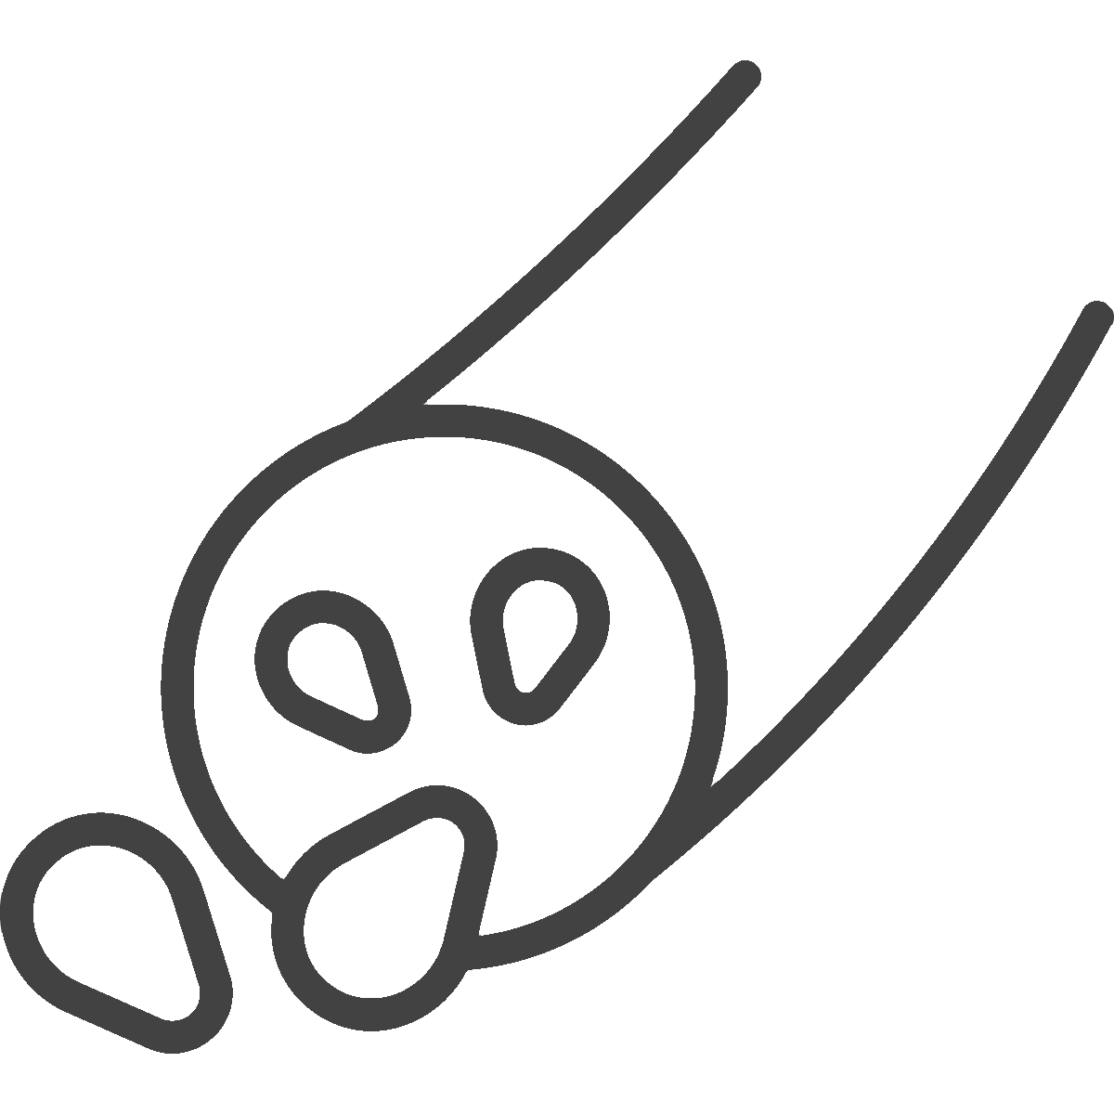

Aetiologies and clinical presentations of nd-CKD^{1,2}
GLOMERULAR
Examples include:
VASCULAR
Examples include:
HEREDITARY
AND CONGENITAL
Examples include:
TUBULOINTERSTITIAL
IgAN
Hypertensive nephrosclerosis
Polycystic kidney disease
Acute
Chronic
FSGS
Renal artery stenosis
Alport syndrome
Membranous nephropathy
INFECTIOUS
AND OBSTRUCTIVE
Mesangial proliferative glomerulonephritis
Other chronic glomerulonephritis
UNKNOWN
ETIOLOGY

Slide 91
Incidence patterns across nd-CKD aetiologies
IgAN¹
Hypertensive nephrosclerosis²
FSGS⁴
≥2.5 cases per 100,000 adults/year
Most common primary glomerulonephritis worldwide
14.97 cases per 100,000 persons/year*
Prevalence, incidence and mortality are rapidly increasing due to population growth and aging
0.1–2.1 cases per 100,000 persons/year
Most common primary glomerular disorder identified in patients with ESKD in the USA
GLOBAL INCIDENCE RATE
Incidence is highest in East Asia; incidence is also increased in the black population (related to the presence of disease-causing APOL1 variants)³
Incidence is highest in the
black population (related to the presence of disease-causing APOL1 variants) and lowest in the white population
GEOGRAPHIC AND RACIAL VARIATION
Incidence is highest in Asian populations and lowest in African populations
More prevalent in male patients compared with female patients (≈2:1 ratio) in North America/ Europe but equally distributed across sexes in Asia
More prevalent in male patients compared with female patients across all age groups
Incidence of adult-onset FSGS
is 1.5–2×higher in male patients
compared with female patients
SEX VARIATION

Slide 92
Components of composite kidney–CV outcome*
Outcome | Finerenone |  | Placebo |  | Hazard ratio (95% CI) |  | p-value
 | n (%) | n per 100 PY | n (%) | n per 100 PY
Composite kidney–CV | 110 (13.9) | 4.7 | 134 (16.9) | 5.8 |  | 0.77 (0.60, 0.99) | 0.043
Kidney failure | 95 (12.0) | 4.0 | 102 (12.9) | 4.4 |  | 0.88 (0.67, 1.17) | 0.381
Sustained decrease of eGFR ≥57% | 77 (9.7) | 3.2 | 98 (12.4) | 4.2 |  | 0.74 (0.55, 1.00) | 0.048
HHF | 8 (1.0) | 0.3 | 9 (1.1) | 0.4 |  | 0.97 (0.39, 2.44) | 0.948
CV death | 3 (0.4) | 0.1 | 9 (1.1) | 0.4 |  | 0.32 (0.09, 1.19) | 0.073
Finerenone better
Placebo better

Slide 93
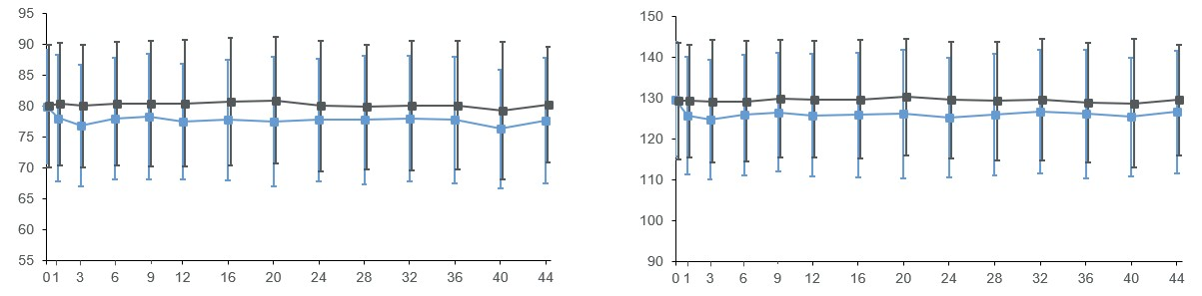
Diastolic and systolic blood pressure
Mean DBP change from baseline to month 3
(mm Hg): −3.1 with finerenone vs −0.01 with placebo
Mean SBP change from baseline to month 3
(mm Hg): −5.1 with finerenone vs −0.1 with placebo
Mean DBP (mm Hg)
Mean SBP (mm Hg)
Mean DBP at baseline:
Finerenone: 80.0±9.2 mmHg
Placebo: 80.1±10.0 mmHg
Placebo
Mean SBP at baseline:
Finerenone: 129.7±13.9 mm Hg
Placebo: 129.3±14.2 mm Hg
Placebo
Finerenone
Finerenone
Months since randomisation
Months since randomisation
791
793
783
784
777
777
766
768
764
763
761
754
747
747
737
739
At risk (n)
Placebo
Finerenone
731
730
719
721
672
675
469
495
283
310
133
151
791
793
783
784
777
777
766
768
764
763
761
754
747
747
737
739
731
730
719
722
672
675
469
495
283
310
133
151
93

Slide 94
Chronic eGFR slope by glomerular disease subtype
(biopsy confirmed)
Chronic eGFR slope | Finerenone |  | Placebo |  | Difference in slopes (95% CI)
 | n | eGFR slope | n | eGFR slope
Overall | 363 | −3.1 | 349 | −4.5 |  | 1.3 (0.8, 1.9)
Glomerular disease subgroup
IgAN | 213 | −3.3 | 174 | −4.5 |  | 1.2 (0.4, 2.0)
FSGS | 73 | −3.0 | 94 | −4.9 |  | 1.9 (0.7, 3.1)
Other glomerular diseases | 27 | −2.5 | 30 | −3.4 |  | 0.9 (−1.1, 2.9)
Membranous nephropathy | 42 | −2.5 | 34 | −3.8 |  | 1.3 (−0.4, 3.1)
MPGN | 8 | −4.3 | 17 | −4.4 |  | 0.2 (−3.1, 3.4)
Placebo better
Finerenone better
Consistent results in participants with biopsy confirmed glomerular disease

Slide 95
Composite kidney and cardiovascular outcomes
Kidney failure
or sustained ≥57% eGFR decrease*
Kidney failure, sustained ≥57% eGFR decrease, HF hospitalisation, or CV death#
HF hospitalisation or CV death‡
0.40
0.40
0.40
0.35
0.35
0.35
0.30
0.30
0.30
0.25
0.25
0.25
0.20
Placebo
Cumulative incidence (%)
Placebo
0.20
0.20
0.15
0.15
0.15
0.10
0.10
0.10
Placebo
Finerenone
Finerenone
0.05
0.05
0.05
Finerenone
0.00
0.00
0.00
0
6
12
18
24
30
36
42
0
6
12
18
24
30
36
42
0
6
12
18
24
30
36
42
Months since randomisation
Months since randomisation
Months since randomisation
457
446
451
437
441
424
430
413
413
400
386
385
228
244
92
110
At risk (n)
Placebo
Finerenone
457
446
456
445
454
444
453
442
450
440
449
439
302
295
121
130
457
446
450
437
439
423
428
411
411
397
384
383
226
243
92
110
Hazard ratio
(95% CI):
0.82 (0.58, 1.15)
0.81 (0.58, 1.13)
0.32 (0.09, 1.17)

Slide 96
Adverse events
Finerenone (n=793)
Placebo (n=791)
Hyperkalaemia*
Patients (%)

Slide 97








INFINITY study design
Objective
To provide reliable estimates of the safety and efficacy of finerenone across the full spectrum of CKD
N=1584
Median follow-up of 3.1 years
N=5662
INFINITY
N=14,574
R
1:1
Finerenone 10 or 20 mg od* (n=7291)
N=12,990
N=7328
Placebo (n=7283)
  Key inclusion criteria^{1–3}
  Aged ≥18 years (with diabetes in
  FIDELIO-DKD and FIGARO-DKD)
  Maximum tolerated dose of ACEi or ARB for ≥4 weeks
  Moderately/severely increased albuminuria
  Serum [K⁺] ≤4.8 mmol/L at screening
  Key exclusion criteria^{1–3}
  FIDELIO-DKD and FIGARO-DKD: Non-diabetic CKD, HbA1c >12%, HFrEF with NYHA Class II-IV
  FIND-CKD: Diagnosis of T1D, T2D, and HbA1c ≥6.5%, symptomatic HFrEF with class 1A indication for MRAs
  Uncontrolled arterial hypertension
  Other kidney disease#
Efficacy outcomes:
  Kidney composite: Time to kidney failure‡ or sustained ≥57% decrease in eGFR
  CV composite: Time to hospitalisation for heart failure or CV death
  Others: Time to dialysis or kidney transplantation, all-cause death
Safety outcomes:
  TEAEs, SAEs, and hyperkalaemia events

Slide 98
Hyperkalaemia*
Patients with diabetes
Patients without diabetes
TE hyperkalaemia
TE hyperkalaemia serious AE
TE hyperkalaemia
TE hyperkalaemia serious AE
Finerenone (N=6489)
Finerenone (N=793)
Event rate (per 1000 PY): 3.7 vs 0.6
HR (95% CI): 6.21 (3.18, 12.12)
Event rate (per 1000 PY): 3.2 vs 2.2
HR (95% CI): 1.48 (0.47, 4.67)
Participants (%)
Placebo (N=791)
Participants (%)
Placebo (N=6474)
P_{interaction}=0.0343
Any
Any
Any
Any
Leading to death
Leading to permanent discontinuation
Leading to hospitalisation
Leading to death
Leading to permanent discontinuation
Leading to hospitalisation
Mean eGFR 58 mL/min/1.73 m²
Mean eGFR 47 mL/min/1.73 m²

Slide 99
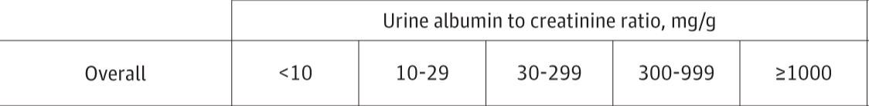
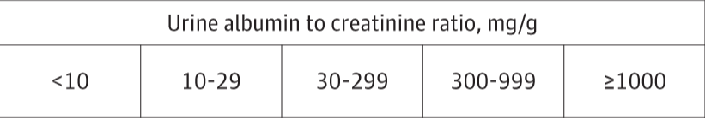
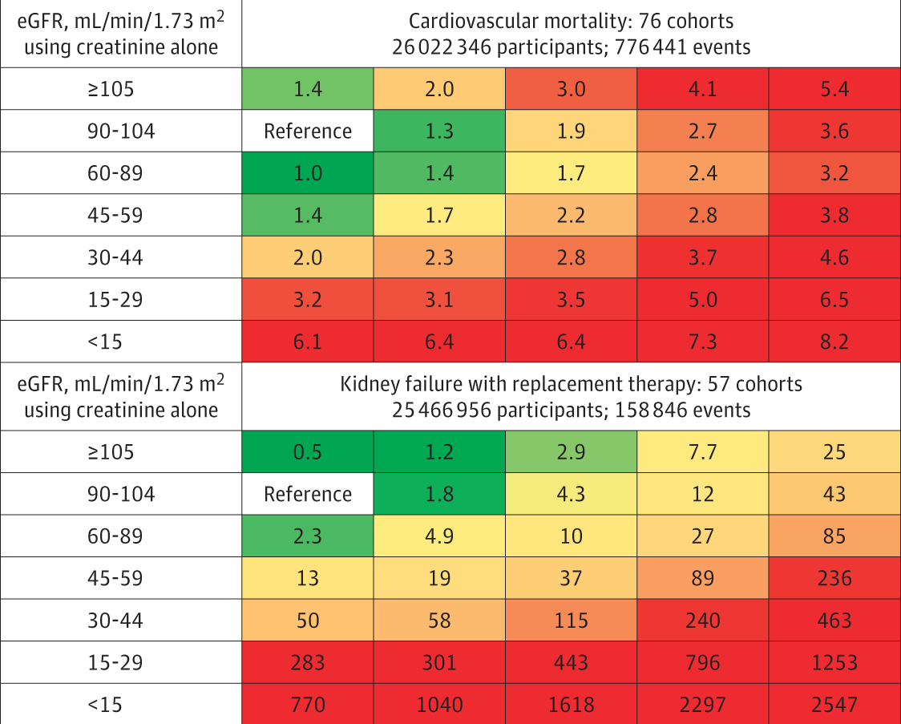
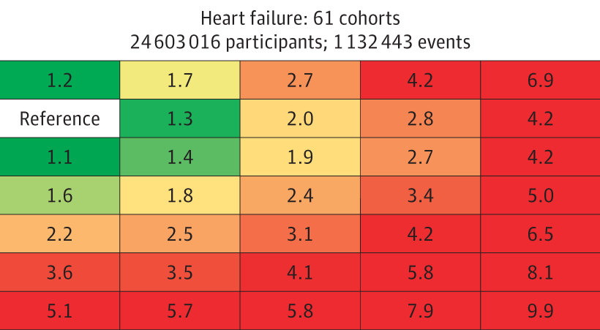
Goal: To mitigate high kidney and CV risk

Slide 100
Estimated absolute effects of finerenone over 3 years
Patients with diabetes
Patients without diabetes
Mean eGFR 58 mL/min/1.73 m²
Median UACR 515 mg/g
9.4
Mean eGFR 47 mL/min/1.73 m²
Median UACR 819 mg/g
3.2
0.2
0.1
Composite kidney-CV outcome*
Composite kidney outcome†
–3.8
–4.0
Composite CV outcome‡
Events prevented or caused per 1000 patients treated over 3 years
Events prevented or caused per 1000 patients treated over 3 years
All-cause death
–11.2
Hyperkalaemia requiring
hospitalisation
–18.4
–15.7
AKI requiring hospitalisation
–33.4
–40.2
–39.0
48.4 | 25.6 | 26.2 | 31.1 | 0.6 | 5.1
58.3 | 54.2 | 6.4 | 11.1 | 2.3 | 3.6
Placebo population event rate per 1000 PY
Placebo population event rate per 1000 PY

Slide 101



Summary
Finerenone preserved kidney function and lowered risk of major adverse kidney and CV events in people with CKD who did not have diabetes
The kidney and CV benefits of finerenone extended across non-diabetic CKD aetiologies, particularly hypertension-related and glomerular diseases (including IgAN and FSGS)
Collectively, finerenone significantly reduced the risks of kidney failure, HF, CV death, and all-cause death across CKD populations with and without diabetes

