Slide 1

Efficacy and safety of finerenone in patients with chronic kidney disease and cardiovascular diseases: An individual participant data pooled analysis (INFINITY)
Carolyn S.P. Lam
on behalf of Rajiv Agarwal, David Z.I. Cherney, Vlado Perkovic, Christoph Wanner, Katherine R. Tuttle, Pantelis Sarafidis, Stefan Anker, Gerasimos Filippatos, Bertram Pitt, J. David Smeijer, Marta Figueras Balsells, Meike Brinker, Hiddo J.L. Heerspink and Brendon L. Neuen.

Slide 2
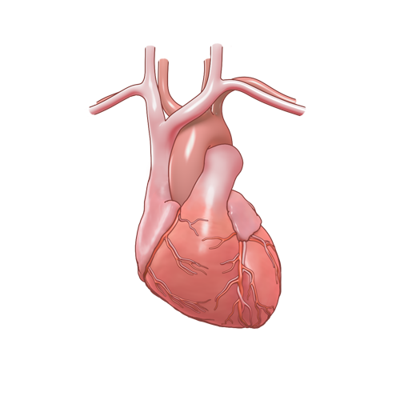
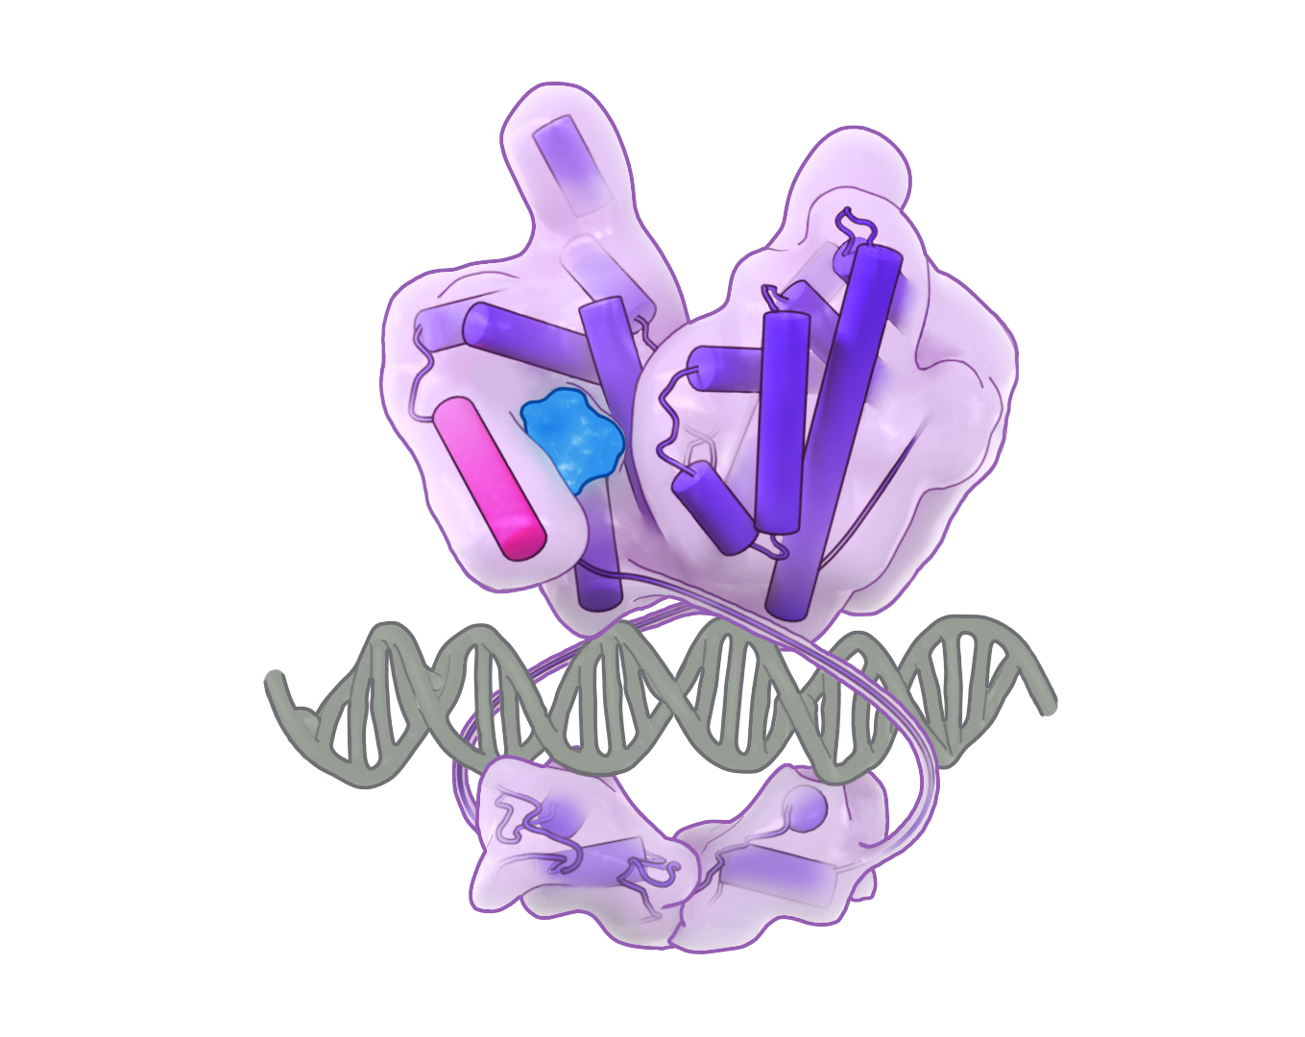
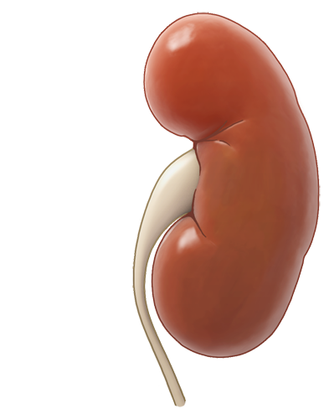


Introduction
CKD and CVD are closely intertwined
  CKD progression increases risk of primary and secondary CVD events and vice versa^{1–4}
MR overactivation represents a shared mechanism for CKD progression and CV complications^{5,6}
Finerenone, a non-steroidal MR antagonist, was shown to reduce the risk of CV and kidney events in patients with CKD in the INFINITY pooled analysis⁷
MR
Finerenone
MR
This analysis examines the interrelationship between CV and kidney events, and the effect of finerenone on this relationship, in the pooled INFINITY dataset covering a broad spectrum of patients with CKD
Notes:
GansevoortR-2013-Lancet-epub.pdf/P2+P2 fig 1A
Vashistha-2016-International Journal of Cardiology.pdf / p1 / Results and Conclusions
Go-N Engl J Med-2004-v351-p1296-305.pdf
P1+Fig 1
Neuen-2024-JACC-v84-p2246/p1, p2
DC OK
Savarese et al_Diabetologia_2024.pdf
P2+P3
KolkhofP-2014-J Cardiovasc Pharmacol-v64-p69.pdf
P1
DC OK
Neuen BL_The Lancet_2026_v407p2375-2386/p1
DC OK

Slide 3





INFINITY: individual participant data pooled analysis in a broad CKD population
R
1:1
Finerenone 10 or 20 mg od* (n=7291)
N=1584
N=14,574
Placebo (n=7283)
N=12,990
Median follow-up of 3.1 years
  CKD and CVD interrelationship
  Time-updated (split-time) analyses comparing incidence rates before and after non-fatal CV and kidney events
  Estimation of all-cause mortality from time of non-fatal CV and kidney events
Efficacy of finerenone on the INFINITY expanded CV composite
  Overall and by-component breakdown
  Effect of CVD history on finerenone efficacy and safety
  Participants with/without a history of CVD
  CVD was defined as: ASCVD (coronary, cerebrovascular or peripheral arterial disease), HF, AF/flutter
  Kidney events:
    CKD progression (sustained ≥40% decrease in eGFR or kidney failure*)
  Non-fatal CV events:
    MI, stroke, AF/flutter, HHF
  Components:
    Non-fatal MI
    Non-fatal stroke
    HHF
    New onset AF/flutter
    CV death
  Kidney composite: Time to kidney failure* or sustained ≥57% decrease in eGFR
  CV composite: Time to HHF or CV death
  Others: Kidney–CV composite, dialysis or kidney transplantation, all-cause death
  Safety outcomes: TEAEs, SAEs and hyperkalaemia events
Notes:
INFINITY_cardio_renal_results_Comp2/3.1.1
DC Note: Draft manuscript methods section used to further support this.
DC suggestions:
For an unfamiliar audience, would it be clearer for the heading of this section to include kidney-CV (i.e., kidney-CV event interrelationship analysis or similar)? – Amended - AKD
In the bullet under “Kidney events”, would suggest amending to “kidney disease progression” or “CKD progression” – Amended - AKD
DC query:
I could not find support for flutter included as a non-fatal CV event combined with AF in the source provided or in figure 1 of the draft ms. However, I was under the impression that these were always taken as a combined outcome in this analysis, so I have not marked it as DC NOT OK, but please double check – have added a comment to the slide that we need to check, it is one of our queries for the next draft of the manuscript - AKD
Otherwise, DC OK
INFINITY_cardio_renal_results_Comp2/2.2
DC OK
INFINITY_cardio_renal_results_Comp2/1.4, 1.6
KF definition:
Neuen BL_The Lancet_2026_v407p2375-2386/p3B
DC Note: Draft manuscript methods section and figures used to further support this; Section 2.3 of the CSR was used to support dialysis or kidney transplantation being reported as a separate outcome
DC Suggestion (heading): “Effect…on finerenone efficacy and safety” or similar? – amended - AKD
DC Query: Should new onset AF/flutter be mentioned here? – I haven’t added as we don’t present these results, but pls amend if preferred! - AKD
Otherwise, DC OK

Slide 4
Baseline demographics and clinical characteristics
Characteristic | With CVD (n=6822) | Without CVD (n=7752)
Age, years, mean ± SD | 66.7 ± 8.7 | 61.0 ± 11.4
Sex, male, n (%)* | 5031 (73.7) | 5076 (65.5)
Race, n (%)
White | 5102 (74.8) | 4415 (57.0)
Asian | 1142 (16.7) | 2586 (33.4)
Black | 261 (3.8) | 296 (3.8)
Medical history, n (%)
Atherosclerotic CVD | 6123 (89.8) | 0 (0.0)
Heart failure | 1042 (15.3) | 0 (0.0)
Atrial fibrillation | 1165 (17.1) | 0 (0.0)
BMI, kg/m², mean ± SD | 31.4 ± 5.9 | 30.5 ± 6.2
Obese, BMI ≥30 kg/m², n (%) | 3752 (55.2) | 3730 (48.2)
Characteristic | With CVD (n=6822) | Without CVD (n=7752)
SBP, mmHg, mean ± SD | 136.6 ± 14.3 | 135.4 ± 14.4
HbA1c, %, mean ± SD | 7.6 ± 1.4 | 7.3 ± 1.5
eGFR, ml/min/1.73 m², mean ± SD | 54.0 ± 19.9 | 58.5 ± 22.4
UACR, mg/g, median (Q1–Q3) | 482.7 (162.8–1104.3) | 633.7 (310.8–1212.1)
Medication use, n (%)
Statins | 5417 (79.4) | 4844 (62.5)
ARBs | 4011 (58.8) | 5038 (65.0)
ACEis | 2803 (41.1) | 2708 (34.9)
SGLT2is | 474 (6.9) | 668 (8.6)
Diuretics | 3789 (55.5) | 3202 (41.3)
Notes:
INFINITY_cardio_renal_results_Comp2/1.2
DC NOT OK for:
Sex: values reported are for male sex (says female on the slide)
Statins: with CVD = 5417 (79.4); without CVD = 4844 (62.5)
Otherwise, DC OK
- Amended - AKD
Neuen BL_The Lancet_2026_v407p2375-2386/p4 Table 1
DC OK

Slide 5
Event incidence before and after CV and kidney events
CKD progression* before and after a non-fatal CV event
Non-fatal CV events before and after CKD progression*
0.5
HHF or CV death before and after CKD progression*
0.5
Before (n = 14,574; 1978 events)
CKD progression* before and after HHF
Before (n = 14,574; 1330 events)
After (n = 1330; 238 events)
After (n = 1978; 138 events)
Before (n = 14,574; 743 events)
Before (n = 14,574; 2087 events)
After (n = 2087; 125 events)
After (n = 469; 129 events)
237 events/1000 PY
0.4
HR: 2.05 (95% CI: 1.79–2.34), P<0.001
0.4
HR: 2.11 (95% CI: 1.76–2.54), P<0.001
0.5
HR: 3.42 (95% CI: 2.80–4.18), P<0.001
0.5
HR: 3.84 (95% CI: 3.21–4.59), P<0.001
0.3
0.4
139 events/1000 PY
0.4
0.3
Cumulative incidence
Cumulative incidence
0.3
0.3
0.2
0.2
Cumulative incidence
59 events/1000 PY
Cumulative incidence
53 events/1000 PY
0.2
19 events/1000 PY
0.2
70 events/1000 PY
0.1
0.1
0.1
0.1
0.0
52 events/1000 PY
0.0
35 events/1000 PY
0.0
0
6
12
18
24
30
36
0
6
12
18
24
30
36
0.0
0
6
12
18
24
30
36
0
6
12
18
24
30
36
Time after randomisation or after CKD progression (months)
Time after randomisation or after HHF (months)
Time after randomisation or after non-fatal CV event (months)
Time after randomisation or after CKD progression (months)
HHF was the CV event most strongly associated with subsequent CKD progression
There is a bidirectional relationship between CKD progression and CV events
in the INFINITY population
CKD progression was most strongly associated with subsequent HHF or CV death
Notes:
INFINITY_cardio_renal_results_Comp2/3.1.1
Note: Section 3.1.3 used to support rate/1000 PY
Suggestion: should kidney failure be defined in the * footnote?
Otherwise, DC OK
Footnote amended - AKD

Slide 6
Effect of non-fatal CV events and CKD progression on subsequent mortality
0.5
40% eGFR decline or kidney failure (n=2216; deaths, n=190)
50% eGFR decline or kidney failure (n=1324; deaths, n=135)
57% eGFR decline or kidney failure (n=1049; deaths, n=113)
Event: subsequent deaths, n per 1000 PY
0.4
HHF (n=597; deaths, n=132)
Non-fatal MI (n=372; deaths, n=66)
HHF: 160
Non-fatal stroke (n=414; deaths, n=63)
New-onset AF/flutter (n=478; deaths, n=86)
57% eGFR decline or kidney failure: 119
0.3
New-onset AF/flutter: 136
Cumulative incidence of death
50% eGFR decline or kidney failure: 104
Non-fatal MI: 114
0.2
40% eGFR decline or kidney failure: 81
Non-fatal stroke: 92
0.1
0
0
6
12
18
24
30
36
Months after index event
Both CKD progression and CV events are associated with increased mortality risk:
HHF results in the highest risk of subsequent death
Notes:
INFINITY_cardio_renal_results_Comp2/3.3
DC suggestions:
In the previous slide, event/1000PY values are shown as whole numbers. For consistency, align between the two slides?
To reduce wordiness on the slide, consider adding a “subsequent deaths per 1000 PYs” heading and then just listing the outcomes and numbers
Amended to whole numbers, please DC
Added heading
Otherwise, DC OK

Slide 7
Treatment effect on expanded CV outcome (non-fatal MI, non-fatal stroke, new onset AF/flutter, HHF and CV death)
25
Outcome | Finerenone (n=7291) |  | Placebo (n=7283) |  | HR (95% CI) |  | p-value
 | n (%) | n/1000 PY | n (%) | n/1000 PY
Non-fatal MI | 177 (2.4) | 8.0 | 195 (2.7) | 8.9 |  | 0.90 (0.73–1.10) | 0.301
Non-fatal stroke | 208 (2.9) | 9.4 | 206 (2.8) | 9.4 |  | 1.00 (0.83–1.22) | 0.983
HHF | 263 (3.6) | 12.0 | 334 (4.6) | 15.3 |  | 0.78 (0.66–0.92) | 0.002
New onset AF/flutter* | 223 (3.3) | 11.0 | 255 (3.8) | 12.6 |  | 0.87 (0.73–1.04) | 0.128
CV death | 182 (2.5) | 8.1 | 220 (3.0) | 9.9 |  | 0.82 (0.67–0.999) | 0.049
Overall (expanded CV composite) | 887 (12.2) | 41.7 | 995 (13.7) | 47.5 |  | 0.88 (0.80–0.96) | 0.004
20
Finerenone
Placebo
15
Cumulative incidence (%)
10
5
0
0
6
12
18
24
30
36
42
48
Months since randomisation
At risk (n)
Finerenone
7291
7124
6945
6730
6046
4971
3650
2457
1200
Placebo
7283
7082
6856
6638
5920
4877
3544
2391
1186
Favours finerenone
Favours placebo
Finerenone significantly reduced the risk of the expanded CV outcome versus placebo, supported by favourable HR estimates in most components
Notes:
INFINITY_cardio_renal_results_Comp2/2.1, 2.2
DC OK (included embedded excel)
DC Note: Checked CV death upper 95% CI versus ms Figure 5 and INFINITY primary paper; all %s calculated

Slide 8
Treatment effect on CV and mortality outcomes by CVD history
Outcome | Finerenone |  | Placebo |  | HR (95% CI) |  | p-interaction
 | n/n (%) | n/1000 PY | n/n (%) | n/1000 PY
HHF or CV death
Overall | 420/7291 (5.8) | 19.1 | 520/7283 (7.1) | 23.9 |  | 0.80 (0.70–0.91)
History of CVD
With | 316/3413 (9.3) | 32.4 | 382/3409 (11.2) | 39.8 |  | 0.82 (0.70–0.95) | 0.574
Without | 104/3878 (2.7) | 8.5 | 138/3874 (3.6) | 11.3 |  | 0.75 (0.58–0.97)
HHF
Overall | 263/7291 (3.6) | 12.0 | 334/7283 (4.6) | 15.3 |  | 0.78 (0.66–0.92)
History of CVD
With | 201/3413 (5.9) | 20.6 | 246/3409 (7.2) | 25.6 |  | 0.81 (0.67–0.97) | 0.446
Without | 62/3878 (1.6) | 5.1 | 88/3874 (2.3) | 7.2 |  | 0.70 (0.50–0.97)
CV death
Overall | 182/7291 (2.5) | 8.1 | 220/7283 (3.0) | 9.9 |  | 0.82 (0.67–0.999)
History of CVD
With | 137/3413 (4.0) | 13.6 | 166/3409 (4.9) | 16.7 |  | 0.82 (0.65–1.03) | 0.950
Without | 45/3878 (1.2) | 3.6 | 54/3874 (1.4) | 4.4 |  | 0.83 (0.56–1.24)
All-cause death
Overall | 569/7291 (7.8) | 25.4 | 642/7283 (8.8) | 28.8 |  | 0.88 (0.79–0.99)
History of CVD
With | 375/3413 (11.0) | 37.2 | 433/3409 (12.7) | 43.5 |  | 0.86 (0.75–0.98) | 0.477
Without | 194/3878 (5.0) | 15.7 | 209/3874 (5.4) | 17.0 |  | 0.93 (0.77–1.13)
Favours finerenone
Favours placebo
Notes:
Hazard ratios:
INFINITY_cardio_renal_results_Comp2/Section 1.5.1
NB for CV death and all-cause death upper limits please use Neuen BL_The Lancet_2026_v407p2375-2386/figure 2
DC OK (including forest plot data)
For n/N and IR/1000 PY overall please use:
Neuen BL_The Lancet_2026_v407p2375-2386/figure 2
DC OK
For n/N and IR/1000 PY by CVD history please use:
INFINITY_cardio_renal_results_Comp2/Section 2.3
DC OK

Slide 9
Treatment effect on kidney and kidney–CV outcomes by CVD history
Outcome | Finerenone |  | Placebo |  | HR (95% CI) |  | p-interaction
 | n/n (%) | n/1000 PY | n/n (%) | n/1000 PY
Kidney composite (≥57% decline in eGFR or kidney failure*)
Overall | 460/7291 (6.3) | 22.3 | 589/7283 (8.1) | 28.8 |  | 0.76 (0.68–0.86)
History of CVD
With | 172/3413 (5.0) | 18.7 | 232/3409 (6.8) | 25.4 |  | 0.76 (0.63–0.93) | 0.966
Without | 288/3878 (7.4) | 25.3 | 357/3874 (9.2) | 31.6 |  | 0.76 (0.65–0.89)
Kidney–CV composite (≥57% decline in eGFR, kidney failure,* HHF or CV death)
Overall | 786/7291 (10.8) | 38.6 | 997/7283 (13.7) | 49.6 |  | 0.77 (0.70–0.85)
History of CVD
With | 424/3413 (12.4) | 47.0 | 549/3409 (16.1) | 61.8 |  | 0.77 (0.68–0.87) | 0.971
Without | 362/3878 (9.3) | 32.0 | 448/3874 (11.6) | 39.9 |  | 0.77 (0.67–0.88)
Dialysis or kidney transplantation
Overall | 189/7291 (2.6) | 8.5 | 240/7283 (3.3) | 10.9 |  | 0.77 (0.64–0.94)
History of CVD
With | 72/3413 (2.1) | 7.2 | 98/3409 (2.9) | 9.9 |  | 0.75 (0.55–1.02) | 0.774
Without | 117/3878 (3.0) | 9.6 | 142/3874 (3.7) | 11.7 |  | 0.79 (0.62–1.01)
Favours finerenone
Favours placebo
Finerenone consistently reduced the risk of CV, kidney and mortality outcomes
in participants with and without a history of CVD
Notes:
Hazard ratios:
INFINITY_cardio_renal_results_Comp2/Section 1.5.1
DC OK (including forest plot data)
Note: HRs for dialysis and kidney transplantation were checked against INFINITY_cardio_renal_results_Comp2/Section 2.3
For n/N and IR/1000 PY overall please use:
Neuen BL_The Lancet_2026_v407p2375-2386/figure 2
DC OK
For n/N and IR/1000 PY by CVD history please use:
INFINITY_cardio_renal_results_Comp2/Section 2.3
DC OK

Slide 10
Prespecified safety outcomes
Prespecified safety outcomes: Hyperkalaemia
Adverse events
Hypotension
Any hyperkalaemia
Serious
adverse events
Serious
hyperkalaemia
Adverse event leading to discontinuation
Hyperkalaemia leading to hospitalisation
Acute kidney injury*
Hyperkalaemia leading to discontinuation
The safety profile of finerenone was generally consistent among participants with and without a history of CVD
Rates of hospitalisations and discontinuations related to hyperkalaemia were low and no fatal hyperkalaemia events were reported
Patients (%)
Notes:
Please DC separate slides in the back-up
Complete
– All DC OK

Slide 11
Summary
HF occupies a central position in the CV–kidney continuum:
HHF was the CV event most strongly associated with subsequent CKD progression
CKD progression was in turn most strongly associated with subsequent HHF or CV death
Among all non-fatal CV and kidney events, HHF identified patients at highest subsequent risk of death
Finerenone reduced HF, kidney and combined kidney–CV outcomes with no detected heterogeneity according to CVD history
Notes:
First, heart failure occupies a central position in the cardiovascular–kidney continuum: hospitalisation for heart failure was the cardiovascular event most strongly associated with subsequent kidney disease progression, and kidney disease progression was in turn most strongly associated with subsequent heart failure or cardiovascular death. Second, among all non-fatal cardiovascular and kidney events examined, hospitalisation for heart failure identified the patients at highest subsequent risk of death. Third, finerenone reduced heart failure, kidney, and combined kidney–cardiovascular outcomes, with no detected heterogeneity according to a history of cardiovascular disease.

Slide 12
Thank you
We thank all participating patients and their families

